Slide 1

Lead Generation 2021
RTC LG Program

Slide 2
Program Basics
Lead Generation Partners
  Homesnap – Concierge
  Curyator

Slide 3
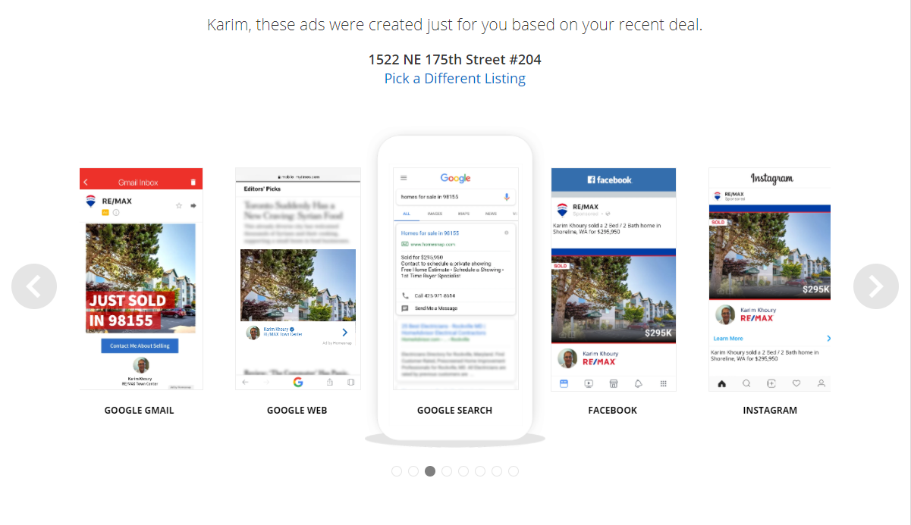
Concierge

Slide 4
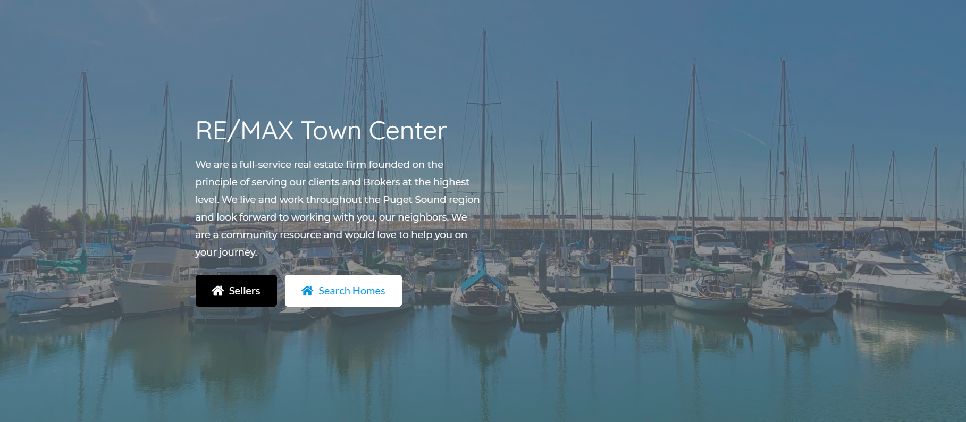
Curyator

Slide 5
What’s included
Lead program includes
Leads
CRM Platform
Leads called for conversion
Office generated conversion strategy for you to follow
Digital remarketing strategy to drive conversion

Slide 6
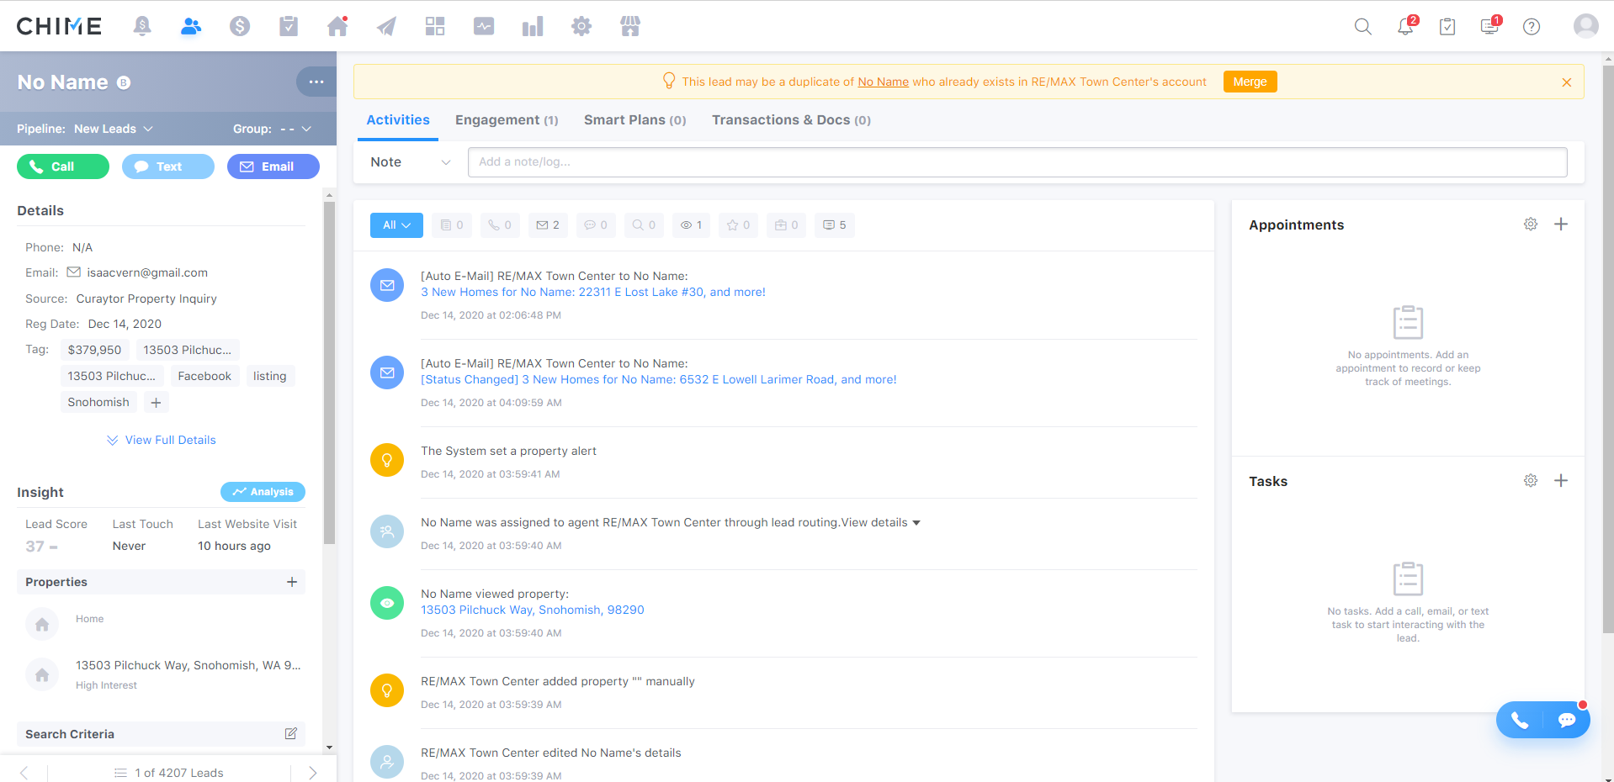
Chime

Slide 7
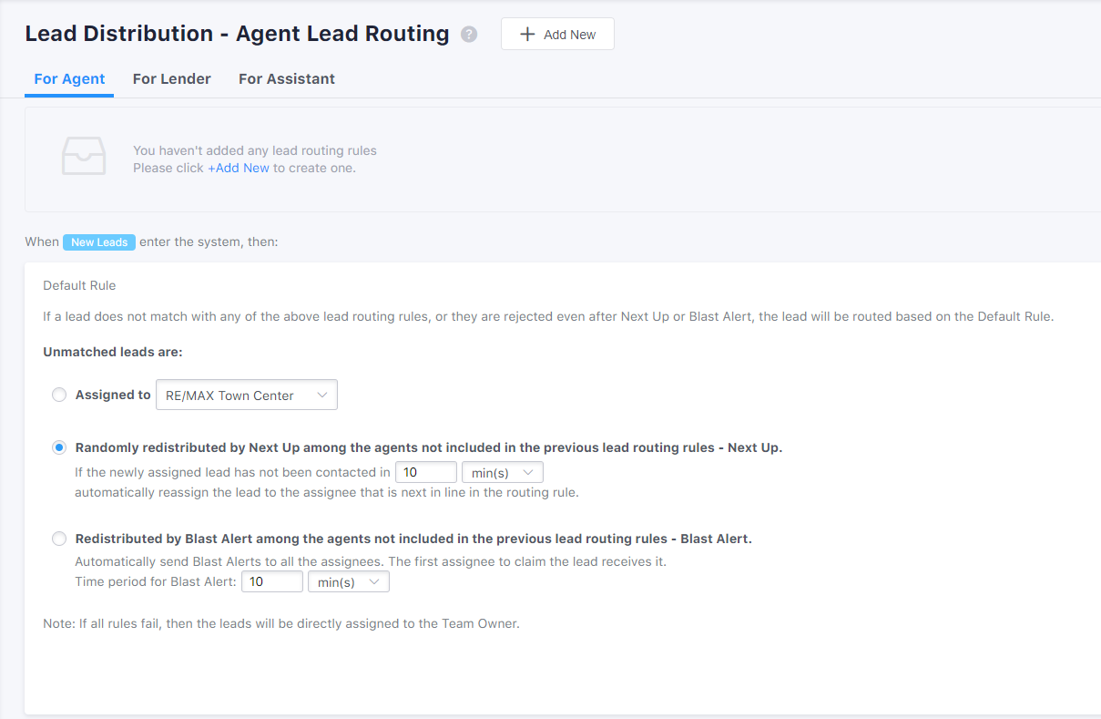
Chime

Slide 8
LEADS
TARGET LEADS: 300/MO.
NO FEWER THAN 30 LEADS/MO./AGENT
LEAD DILLUTION:
  IF MORE THAN 10 AGENTS ARE IN THE PROGRAM WE WILL INCREASE THE NUMBER OF LEADS!

Slide 9
Life of a Lead
Lead Generated
Lead called by Concierge
Lead placed in CRM w/Notes
Agent Notified of New Lead
Lead contacted by Conierge
Live Transfer to Karim for Conversion

Slide 10
Life of a Lead
If Lead Not contacted
RTC/Agent to Implement Conversion Program
Agent to Call Lead
ReMarketing Launched
Schedule Appt.
Slow Drip

Slide 11
Requirements
Monthly Fee: $125
Splits 70/30, does not apply to CAP
Must update leads in Chime within 24 hours of contact
Must attend weekly meetings and provide updates
  Agree to share experiences and best practices
Agree to call leads up to 12 times, as necessary
Agree to implement lead conversion strategies
Must notify office if you will be unavailable to take leads
Adam will manage LG program

