Slide 1
As a reminder, RE/MAX, LLC holds the copyright on all Momentum Training Materials. Do not distribute this PowerPoint presentation or any other Momentum Materials beyond your office. Please take time to read the additional information below regarding the use of these materials.
THE PURPOSE OF THE MOMENTUM PROGRAM
As a RE/MAX Affiliate, you’re a member of the most professional, most productive real estate network in the world.
There are many decisions you must make each and every day to run a successful business. The Momentum program provides basic information to help you. Please note: The Momentum program and materials are designed as a resource to reference.
The suggestions made within are not mandatory.
FOR ILLUSTRATION ONLY
Certain sections of the Momentum materials illustrate how making changes to numbers, such as for costs and expenses, can ﬁnancially impact an agent’s business. These sections are meant to be illustrations only and are not intended to be an exhaustive list of costs that may impact your business or to be speciﬁc to your situation. RE/MAX, LLC makes no promises, representations or guarantees of any kind about the success or proﬁtability of your operations.
CONFIDENTIALITY AND RESTRICTIONS ON USE
Momentum materials, including the attached files, are for use by RE/MAX Affiliates only. Momentum materials, including the attached files, are the confidential property of RE/MAX, LLC. Any possession is considered to be a loan of assets and trade secrets, and the materials must be returned to RE/MAX, LLC should recipient’s association with RE/MAX terminate.
TRADEMARKS AND REGULATIONS
In communicating your affiliation with RE/MAX in person, online or through promotional materials, please reference the RE/MAX Brand Identity: Trademark and Graphics Standards guide to ensure proper use of the RE/MAX name and marks.
Whenever you engage in telemarketing (including marketing via text messaging) or e-mail marketing, ensure that your marketing complies with all applicable federal, state and provincial laws and regulations, including the CAN-SPAM Act, the Telephone Consumer Protection Act, and the Telemarketing Sales Rule. RE/MAX Affiliates are not permitted to use the RE/MAX marks in connection with any of the following marketing methods: pre-recorded telemarketing messages, auto-dialed telemarketing calls or auto-dialed marketing texts to mobile devices, or unsolicited marketing facsimiles. Moreover, other forms of manually dialed telemarketing calls and the use of marketing emails must also comply with federal and state laws if the RE/MAX marks are in use.
When cold calling, be aware of the requirements of the national (and, if applicable, state) Do Not Call Registry before placing calls. Additionally, be aware of federal and state laws regarding calling consumers before 8 a.m. or after 9 p.m.
RE/MAX offices are independently owned and operated.

Slide 2
Power of Video Boot Camp

Slide 3
COURSE OVERVIEW
PURPOSE:
To increase basic skill and confidence when implementing video into your business plan and dollar-productive activities.
EXPECTATION:
Upon completing this class, you should feel confident enough to incorporate video messaging into your dollar-productive activities.
STRATEGY:
Creating a Human Connection to generate more relational capacity with clients, and in turn lead to more sales and greater productivity.
RELATED COURSES:
All Lead Generation Courses
All Lead Conversion Courses
Social Media Boot Camp & Marketing Boot Camp

Slide 4
PLAN
Become Intentional & Proactive
Define Aspirations
Develop GPS
Implement Vital Activities
Be Accountable
Your Personal Brand
Identify Audience
Determine Content Gap
Determine Value
Be a Storyteller
Your Video System
Personalize Video Script
Tactics, Tips & Resources
Value-Driven Content
Establish a Schedule
Track, Evaluate, Improve
Become Dollar-Productive
The 47 Vital Listing Activities
The 47 Vital Buyer Activities
Marketing
Client Care

Slide 5
SUMMARY
The Power of Video teaches you how to build a complete video system through personal branding and dollar-productive activities. You’ll learn how to identify your personal brand, as well as how to deliver value-driven content to your ideal audience through storytelling.
This class will provide basic concepts and activities- designed to establish confidence and ability- around video messaging.
As an end result, you will then be able to leverage video within your vital activities. Tools you will need to create a beginner video system are provided within this course.

Slide 6
SECTION 1
VIDEO & YOUR BRAND

Slide 7
WHY VIDEO?
Video is an extremely powerful tool to incorporate within your
business plan for a number of reasons:
Humanize yourself (Put a personality to the name)
Create relatability with your audience
Establish credibility as the subject matter expert
First-hand display of your character, expertise, and knowledge
Deliver an experience that stands out above the crowd
Strengthen relationships and build new ones
Most importantly, the average video message is outperforming
it’s non-video counterpart!

Slide 8
WHY VIDEO?
LEVERAGING VIDEO: FINANCIAL PROOF
Homeowners say that they are more likely to list with a real estate agent who uses video.
Marketing professionals, worldwide, name video as the type of content with the best return on investment (ROI).
Video drives an increase in organic traffic from search engine results pages.
Initial emails with a video receive an increased click-through rate.
Marketers who use video, grow revenue faster than non-video users.
...yet, few Realtors use video in their marketing!
Notes:
REFERENCES:
According to the National Association of Realtors: https://www.nar.realtor/research-and-statistics/quick-real-estate-statistics
According to a study conducted by Syndacast: https://www.syndacast.com/video-marketing-statistics-trends-2015/
According to Brightcove: https://www.brightcove.com/en/blog/2015/08/create-compelling-video-experiences
According to GetResponse: https://www.getresponse.com/about/press-center/releases/01-12-2009.html
According to a study conducted by VidYard/Aberdeen Group: http://awesome.vidyard.com/rs/273-EQL-130/images/Vidyard_Aberdeen_Impact_of_Video_Marketing.pdf

Slide 9

WHY AREN’T YOU LEVERAGING VIDEO?
For many, utilizing video messaging is out of our comfort zone.
One of the requirements of growth, and therefore success, is having the courage to step outside of that comfort zone.
In the spirit of expanding your comfort zone, let’s establish why you may be avoiding video messaging.
Lack of Motivation → No Vision
Lack of Direction → No Plan
Lack of Ability → No Skill-set
Lack of Focus → No Discipline
Lack of Support → No Community or Mentorship

Slide 10

BUILDING YOUR PERSONAL BRAND
THE “MUST-HAVES” OF CREATING A PERSONAL BRAND
Must be an authentic manifestation of who you are
Must be a reflection of what you do (services you provide, examples of your expertise and knowledge)
Must amplify what you believe
Must be a thoughtful display of your ideals (personality, values, and beliefs)

Slide 11

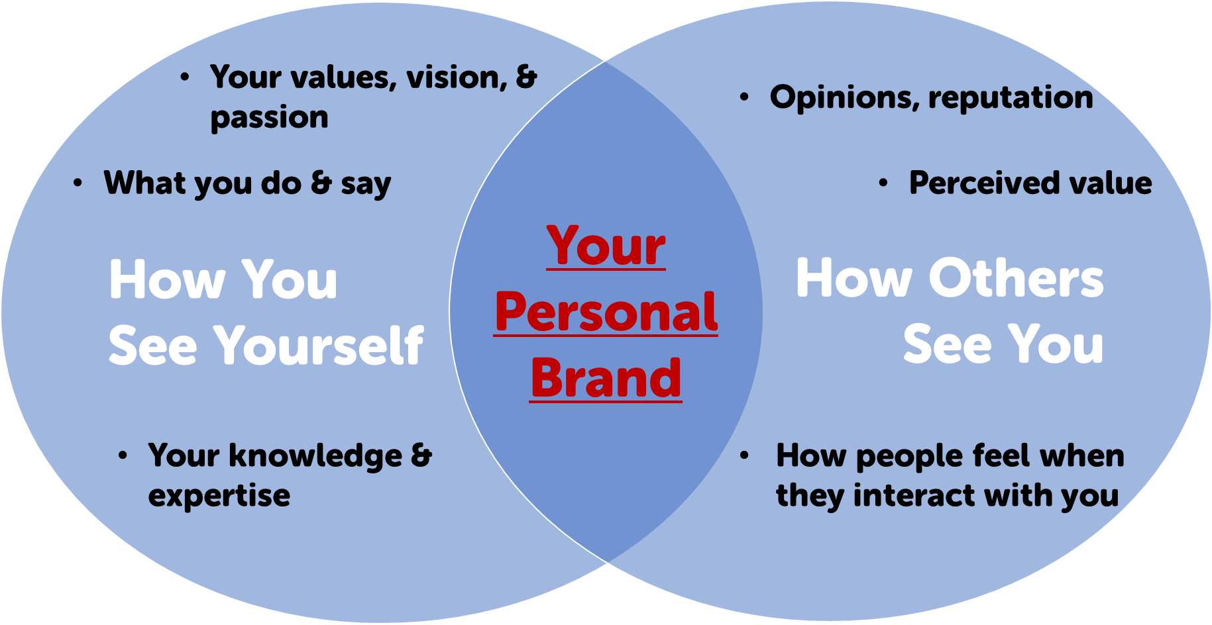
BUILDING YOUR PERSONAL BRAND
What 1 word would you use
to describe yourself?
________________________________
What 1 word would others use
to describe you?
________________________________

Slide 12
YOUR PERSONAL BRAND STORY
An important element to your personal brand,
is the story you’re telling.
The “Golden Rule” of video messaging is to
BE A STORYTELLER!
Your story is the purpose of your brand in a narrative setting.
The most important element to becoming a storyteller, is to create an emotional connection with your viewer.
Remember: “the mind justifies what the heart decides!”.
When narrating your story, lead with emotion.

Slide 13
S
Stand Out
Identify why you are unique.
What makes you different from other agents?
T
The Expert
Establish what you want to be known for.
What is your focus & area of expertise?
O
Onlookers
Identify your ideal target audience.
Who do you want to hear your story?
R
Relevant
What content is relevant and valuable to your audience?
Y
Yearning
Identify what type of content your audience is currently missing.
What is no one else doing in a way you can?

Slide 14
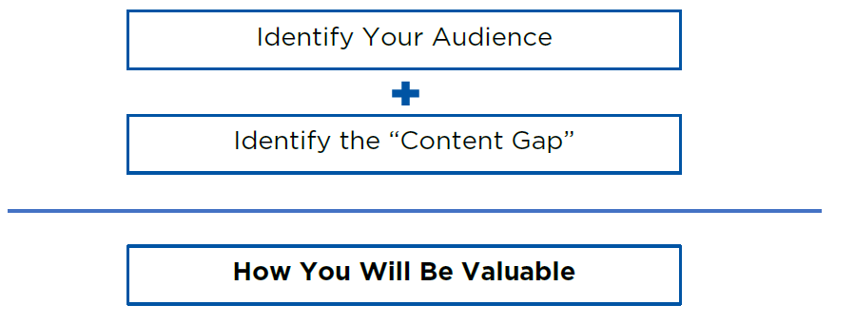
DELIVERING VALUE WITHIN YOUR STORY
“How will I be valuable to my audience?”
In other words, what does your audience need in order to:
Be powerfully impacted to change behavior or actions?
Increase education on desired topics?

Slide 15
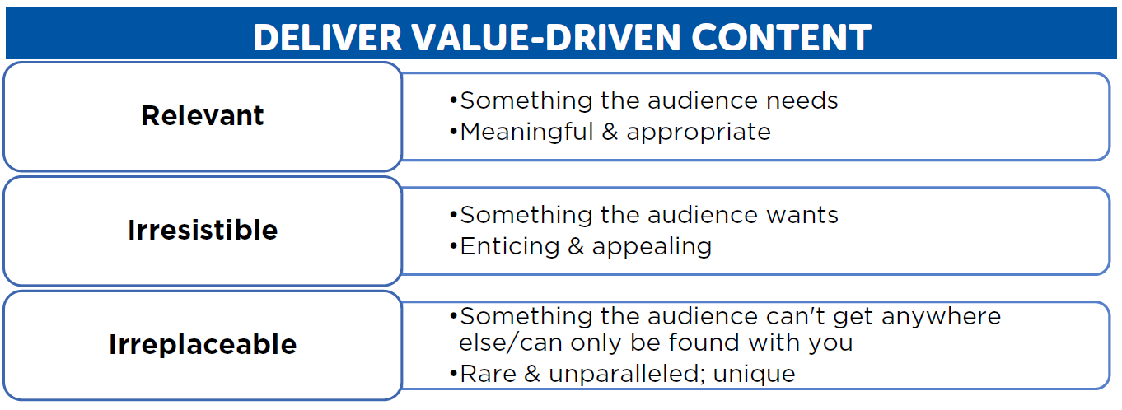
DELIVERING VALUE WITHIN YOUR STORY
When considering what content is most valuable to your audience, establish/position yourself as a “resource hub” for your audience.

Slide 16
SECTION 2
BECOMING INTENTIONAL,
PROACTIVE,
& DOLLAR-PRODUCTIVE

Slide 17
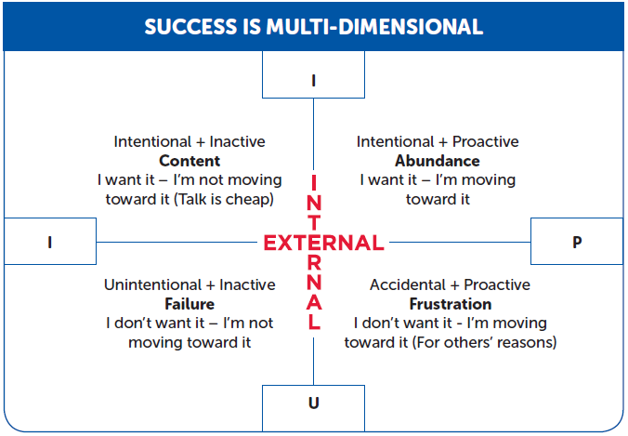
BEING INTENTIONAL & PROACTIVE
Notes:
REFERENCE
“Real Estate Perspectives” Agent Training course within the Momentum 1.0 18 Core Agent Development Courses

Slide 18
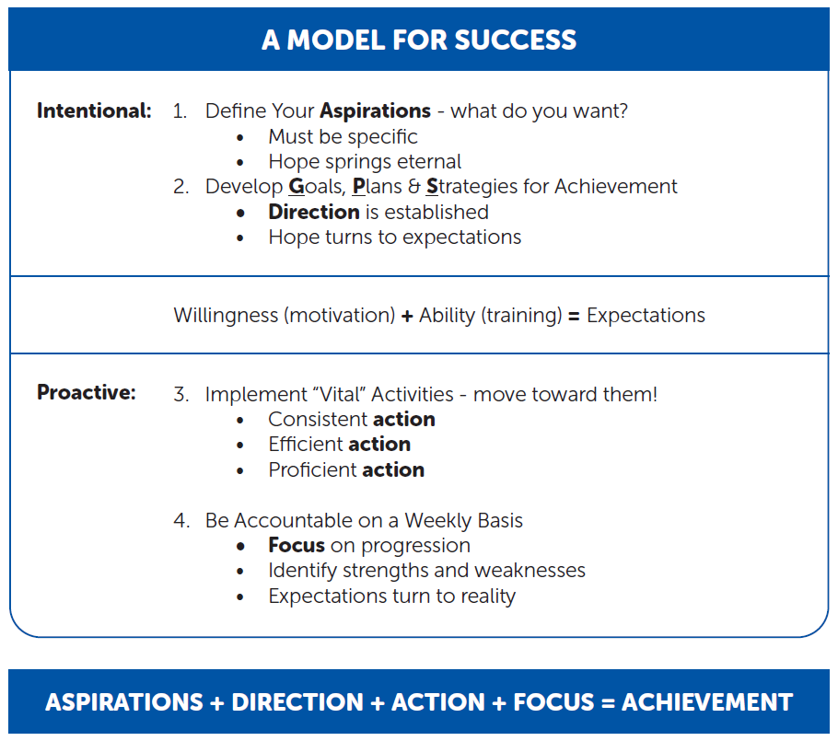
BEING INTENTIONAL & PROACTIVE
Notes:
REFERENCE
“Real Estate Perspectives” Agent Training course within the Momentum 1.0 18 Core Agent Development Courses

Slide 19
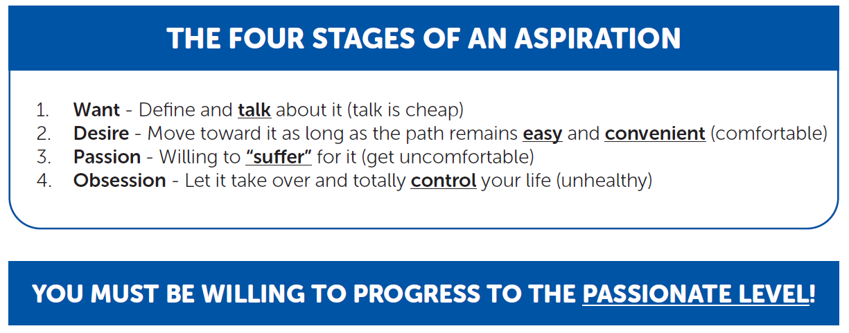
BEING INTENTIONAL & PROACTIVE
Define your video aspiration (goal).
How badly do you want it?
(What is your current stage of aspiration for your goal?)
Notes:
REFERENCE
“Real Estate Perspectives” Agent Training course within the Momentum 1.0 18 Core Agent Development Courses

Slide 20
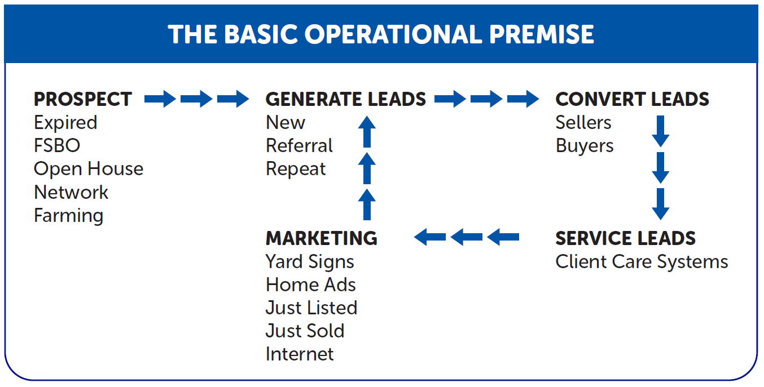
BEING DOLLAR-PRODUCTIVE
Notes:
REFERENCE
“Real Estate Perspectives” Agent Training course within the Momentum 1.0 18 Core Agent Development Courses

Slide 21
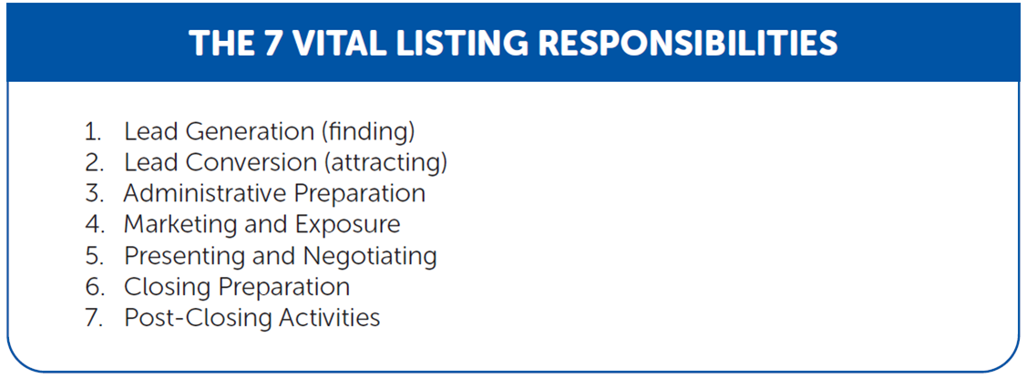
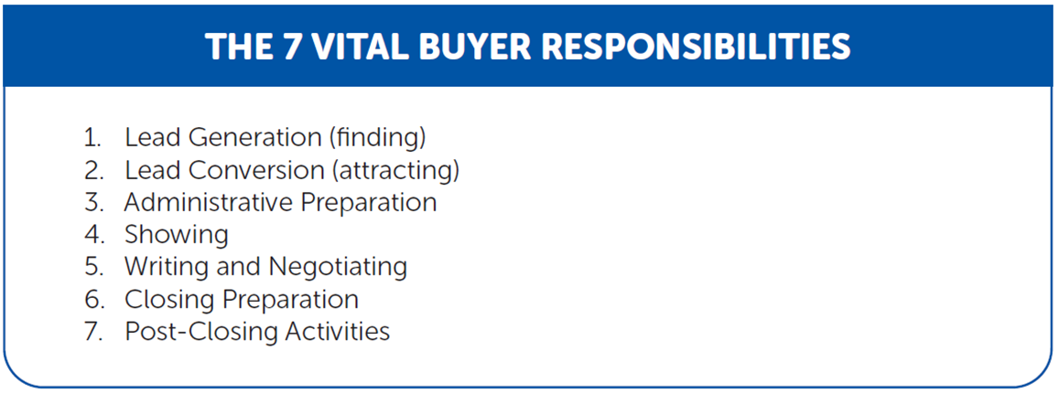
BEING DOLLAR-PRODUCTIVE
Notes:
REFERENCE
Found in various Agent Training courses within the Momentum 1.0 18 Core Agent Development Courses

Slide 22

VIDEO + THE 47 VITAL LISTING ACTIVITIES
Video messaging is proven to be a very effective,
meaningful way to communicate with clients
during the Vital Listing Activities.
Follow this symbol to identify specifically where video can be leveraged within the 47 Vital Listing Activities.
Document ideas on how to incorporate video into the Vital Listing Activities.

Slide 23
VIDEO + THE 47 VITAL BUYER ACTIVITIES
Video messaging can also be leveraged
to communicate with buyers
during the Vital Buyer Activities.
Follow this symbol to identify specifically where video can be leveraged within the 47 Vital Buyer Activities.
Document ideas on how to incorporate video into the Vital Buyer Activities.

Slide 24
SECTION 3
USING SCRIPTS
FOR
VIDEO MESSAGING

Slide 25
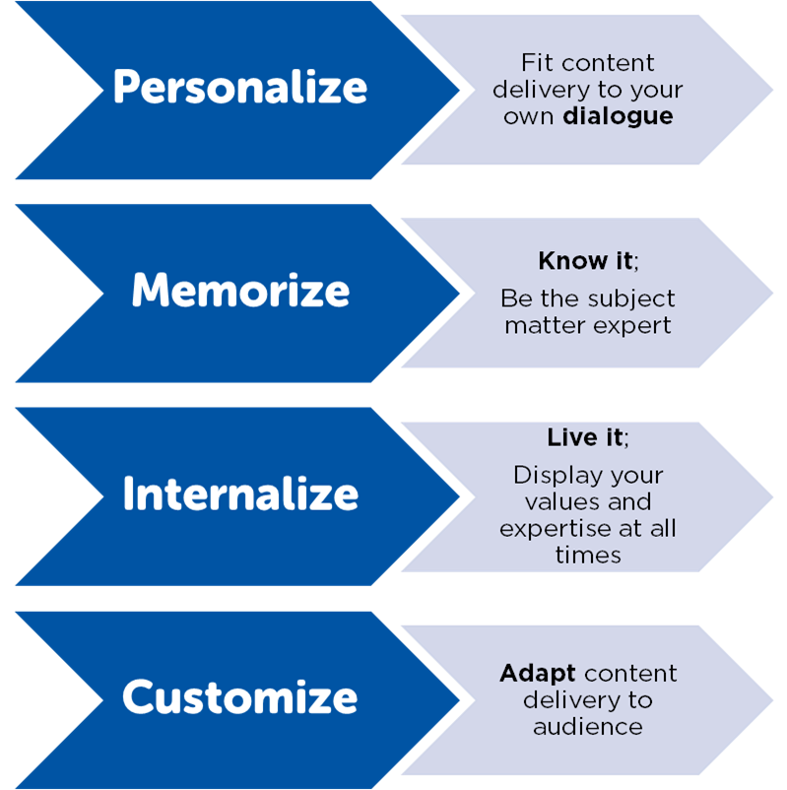
Before you incorporate video messaging into your dollar-productive/vital activities, take a
proactive + intentional approach by
mapping out your message ahead of time.

Slide 26
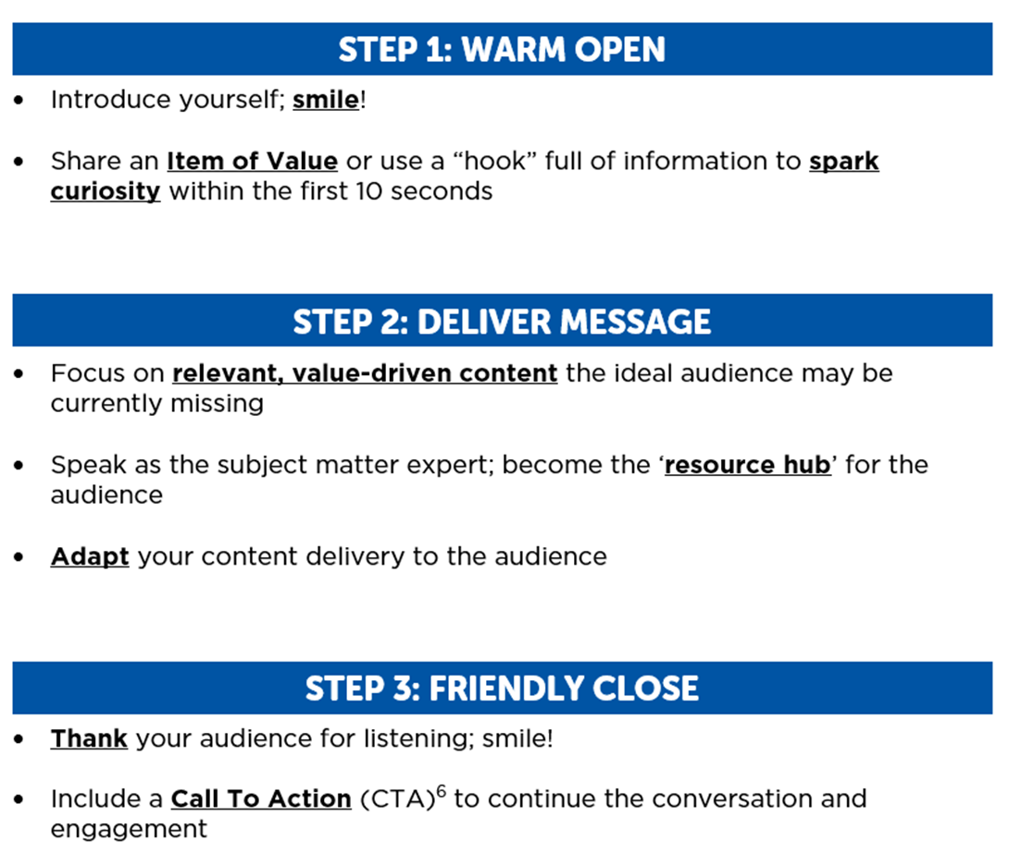
BUILDING YOUR VIDEO SCRIPT
Notes:
REFERENCE
“Connecting With a Call To Action (CTA)” in Section #4

Slide 27
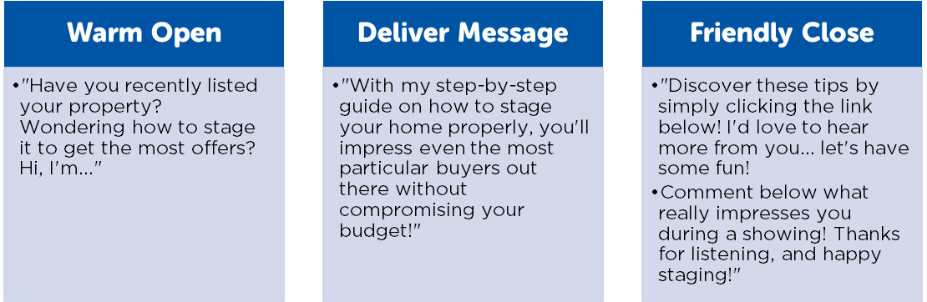
BUILDING YOUR VIDEO SCRIPT
Build Your Own Video Script.
Practice the Structure + Flow of your script with a partner!

Slide 28
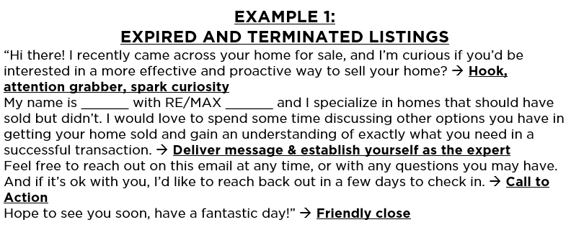
LEAD GENERATION & VIDEO
LISTING LG ACTIVITIES: VIDEO SCRIPT EXAMPLES

Slide 29
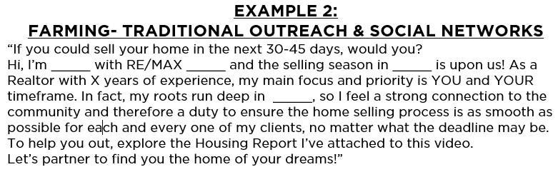
LEAD GENERATION & VIDEO
LISTING LG ACTIVITIES: VIDEO SCRIPT EXAMPLES

Slide 30
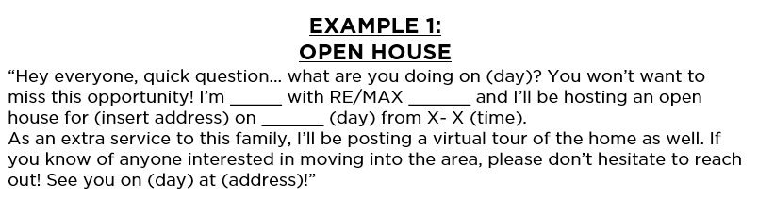
LEAD GENERATION & VIDEO
BUYER LG ACTIVITIES: VIDEO SCRIPT EXAMPLES

Slide 31
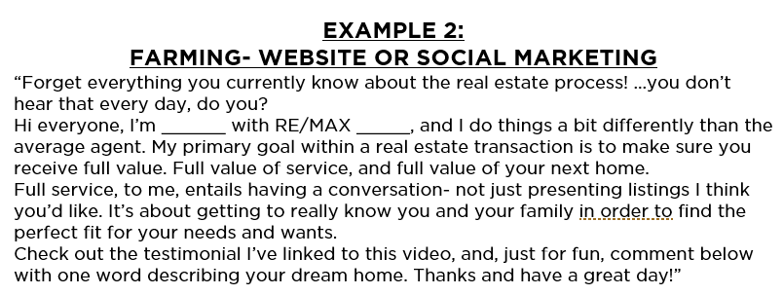
LEAD GENERATION & VIDEO
BUYER LG ACTIVITIES: VIDEO SCRIPT EXAMPLES

Slide 32


LEAD GENERATION & VIDEO
LISTING LG ACTIVITIES: VIDEO SCRIPT EXAMPLES
BUYER LG ACTIVITIES: VIDEO SCRIPT EXAMPLES

Slide 33
LEAD CONVERSION & VIDEO
Utilizing video within your Lead Generation Vital Activities may present opportunities to convert those leads into lifelong clients and,
most importantly, advocates for your brand.
Within the Lead Conversion language, try to be as specific and personal to the individual/family as possible.

Slide 34
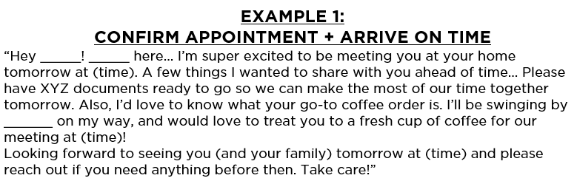
LEAD CONVERSION & VIDEO
LISTING LC ACTIVITIES: VIDEO SCRIPT EXAMPLES

Slide 35
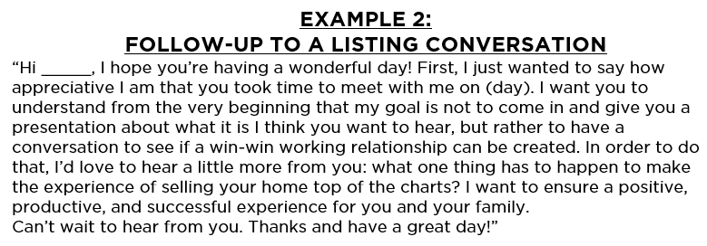
LEAD CONVERSION & VIDEO
LISTING LC ACTIVITIES: VIDEO SCRIPT EXAMPLES

Slide 36
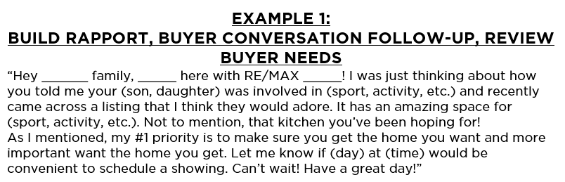
LEAD CONVERSION & VIDEO
BUYER LC ACTIVITIES: VIDEO SCRIPT EXAMPLES

Slide 37
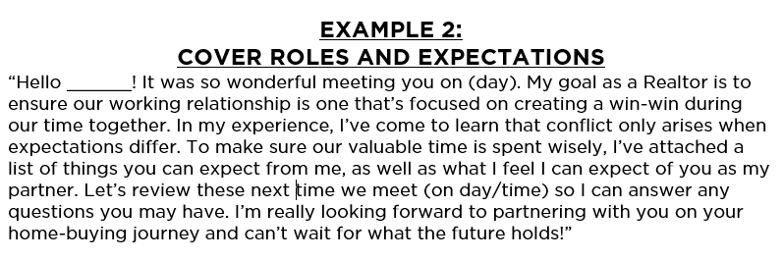
LEAD CONVERSION & VIDEO
BUYER LC ACTIVITIES: VIDEO SCRIPT EXAMPLES

Slide 38


LEAD CONVERSION & VIDEO
LISTING LC ACTIVITIES: VIDEO SCRIPT EXAMPLES
BUYER LC ACTIVITIES: VIDEO SCRIPT EXAMPLES

Slide 39
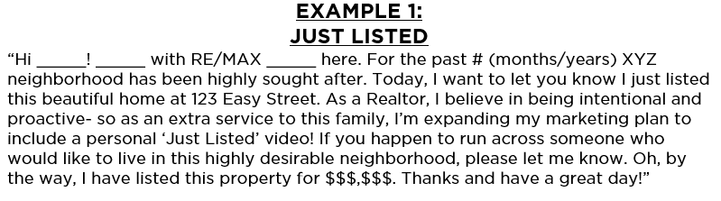
MARKETING & VIDEO
MARKETING: VIDEO SCRIPT EXAMPLES

Slide 40
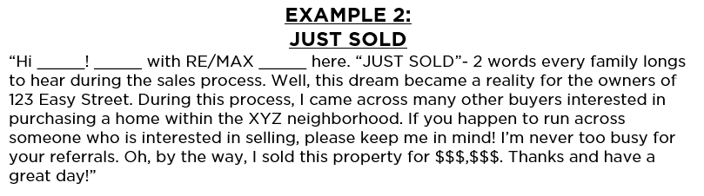

MARKETING & VIDEO
MARKETING: VIDEO SCRIPT EXAMPLES

Slide 41

STAYING IN FLOW
WITH CLIENTS VIA VIDEO
Leverage the humanizing element to video messaging in an effort to nurture your relationships and stay in flow with your sphere on a regular basis.

Slide 42
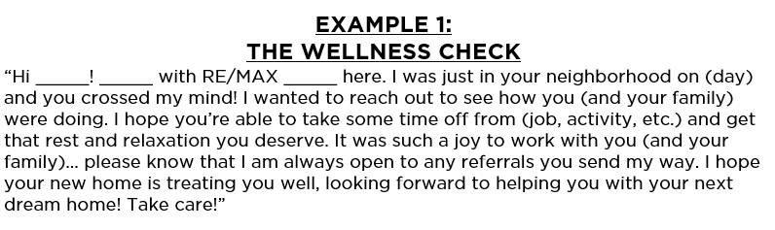
STAYING IN FLOW
WITH CLIENTS VIA VIDEO
VIDEO + YOUR CLIENT CAR SYSTEM: VIDEO SCRIPT EXAMPLES

Slide 43
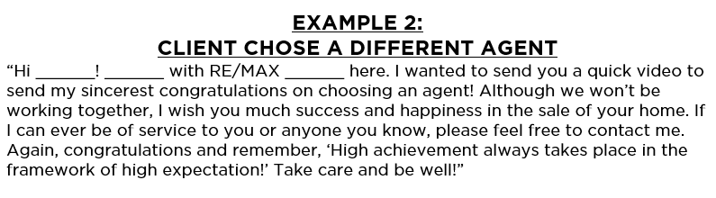

STAYING IN FLOW
WITH CLIENTS VIA VIDEO
VIDEO + YOUR CLIENT CAR SYSTEM: VIDEO SCRIPT EXAMPLES

Slide 44
SECTION 4
PRACTICAL APPLICATION:
BEST PRACTICES &
TIPS FROM THE PROS

Slide 45
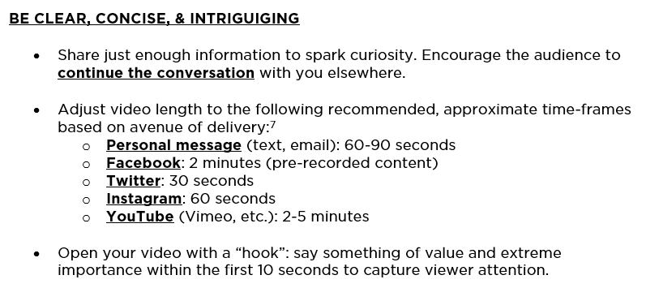
GETTING TACTICAL

Slide 46
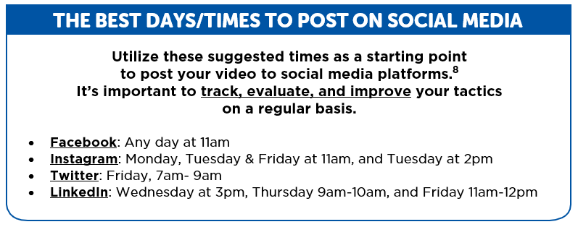

GETTING TACTICAL
Notes:
REFERENCES
7. According to https://2060digital.com/blog/right-video-length-platform/
8. According to a RE/MAX News article: https://news.remax.com/stop-everything-and-make-these-4-social-media-changes

Slide 47
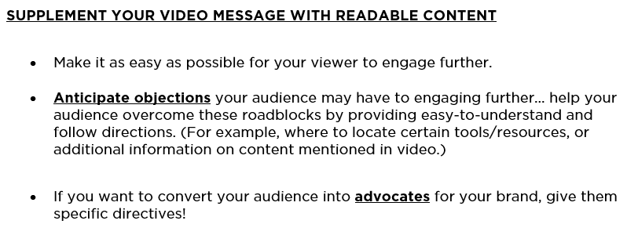
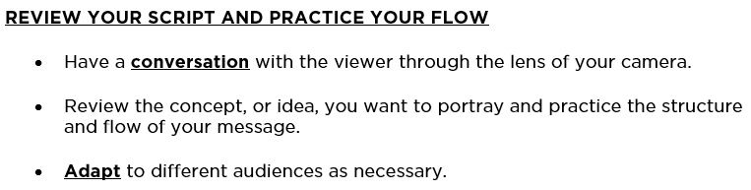
GETTING TACTICAL

Slide 48
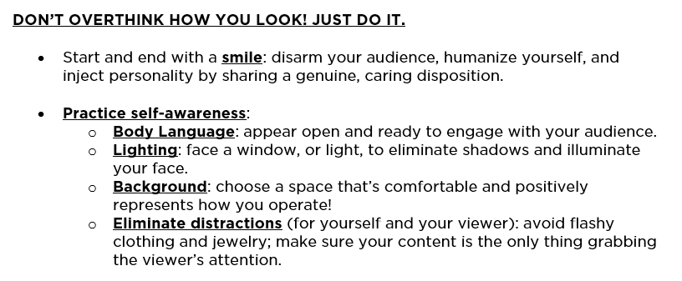
GETTING TACTICAL

Slide 49
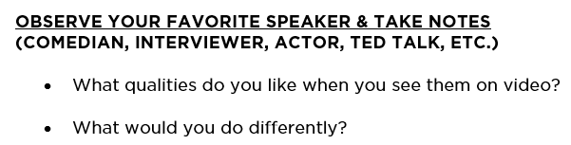
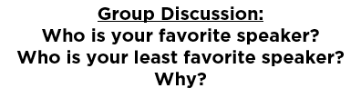

GETTING TACTICAL

Slide 50
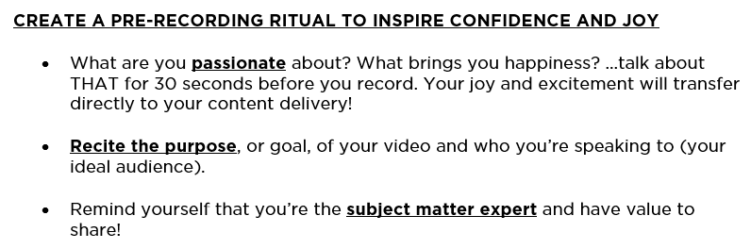

GETTING TACTICAL

Slide 51
CONNECT WITH A
“CALL TO ACTION” (CTA)
Including a “Call to Action” (CTA) within your video message
is a great, proven way to encourage
your viewers to continue engagement
AND is a pathway to gather valuable information
for proactive outreach.
To avoid sounding “salesy”, focus on selling the benefits of taking action and the impact the action could have on the viewer’s life or current situation.
Be genuine and remember your purpose and who you’re trying to serve.

Slide 52
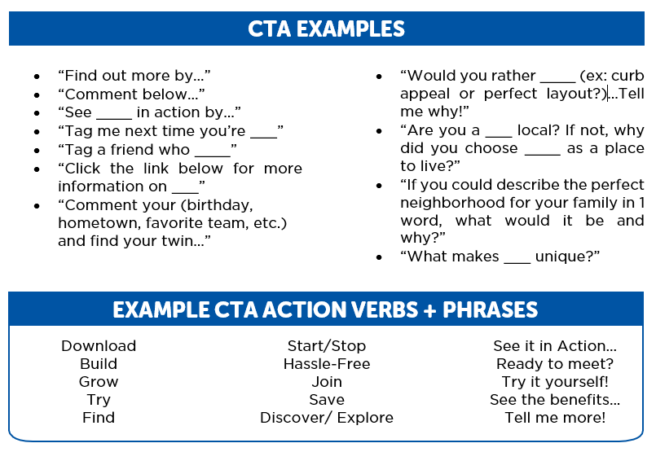
CONNECT WITH A
“CALL TO ACTION” (CTA)

Slide 53
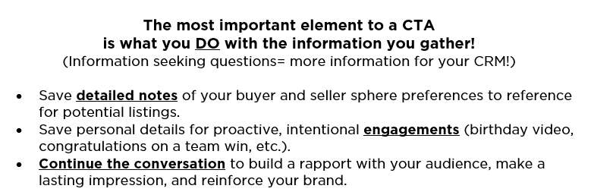
CONNECT WITH A
“CALL TO ACTION” (CTA)

Slide 54

SAMPLE CONTENT TOPICS
A great place to start is a simple “Who I Am & What I Do” video to introduce yourself, establish your brand, and start building a foundation as the subject matter expert.

Slide 55
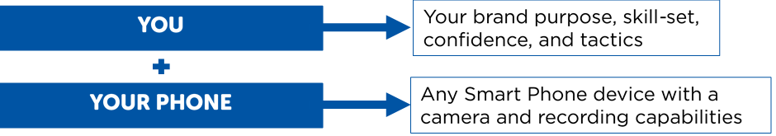
VIDEO TOOLS & RESOURCES: 101

Slide 56
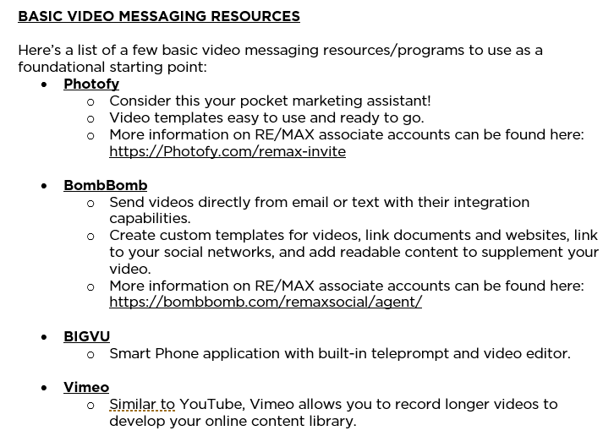
VIDEO TOOLS & RESOURCES: 101

Slide 57
SECTION 5
ESTABLISH
YOUR VIDEO
SYSTEM

Slide 58

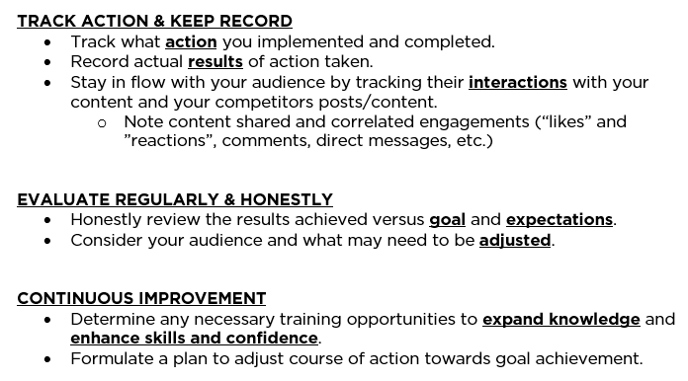
TRACK, EVALUATE, & IMPROVE

Slide 59

TRACK, EVALUATE, & IMPROVE
According to a Harvard study, individuals who had accountability partners saw a 33% increase in their productivity.
Who will help you honestly evaluate your
activity and create success habits?
How often will you meet for evaluation meetings?
Notes:
REFERENCES
1. https://corpgov.law.harvard.edu/2019/12/17/the-case-for-individual-audit-partner-accountability/
2. Evaluation Tracking Tool available in Conclusion

Slide 60
DESIGN & IMPLEMENT
YOUR SYSTEM
Let’s put all the pieces of your personal brand, best video practices, and the knowledge you’ve acquired into a comprehensive, foundational plan.
*Complete Workbook Exercise*
Notes:
REFERENCE
Video System & Schedule Tool available in Conclusion

Slide 61
CONCLUSION
PUTTING IT
ALL
TOGETHER

Slide 62
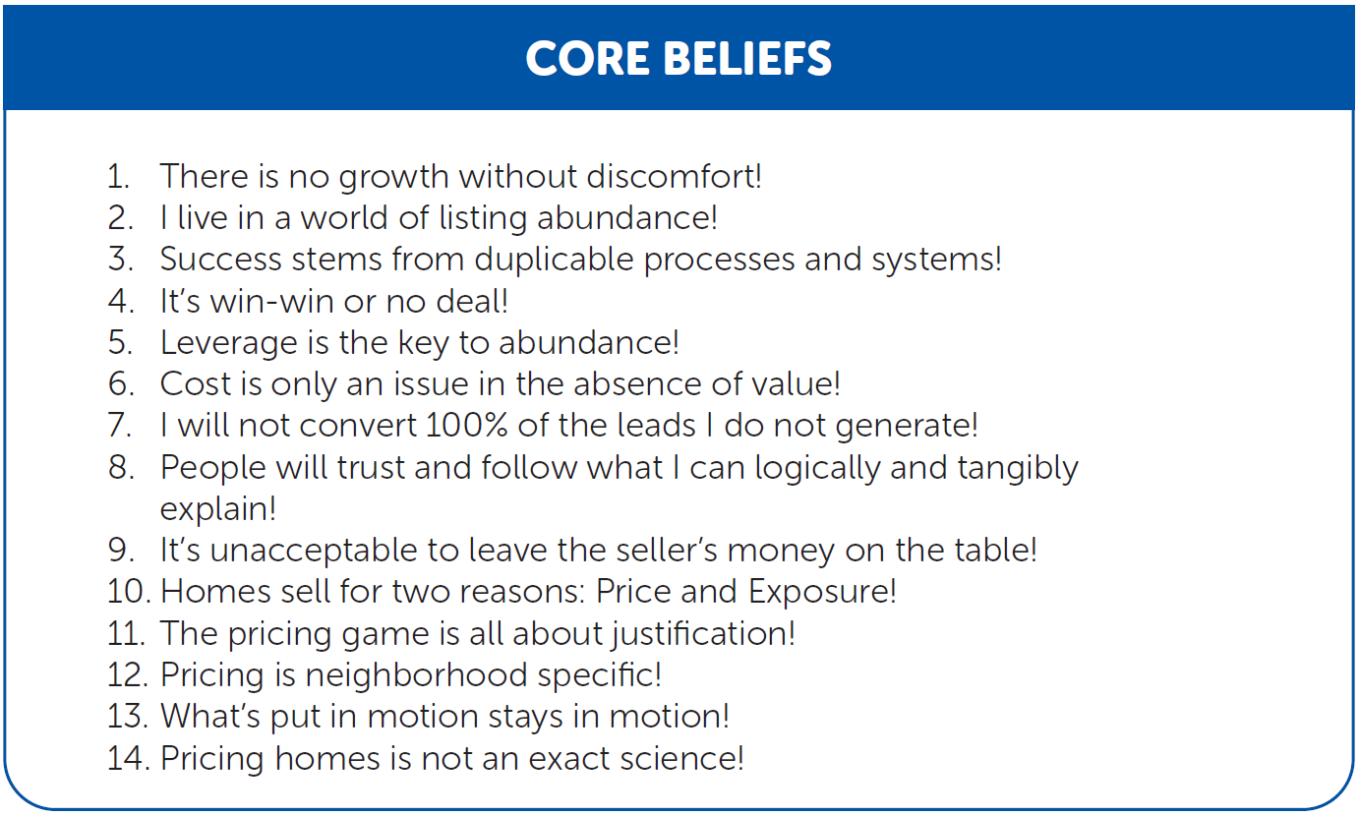
GETTING ON THE VIDEO CHANNEL
The following beliefs are most important within LISTING CONVERSION:

Slide 63
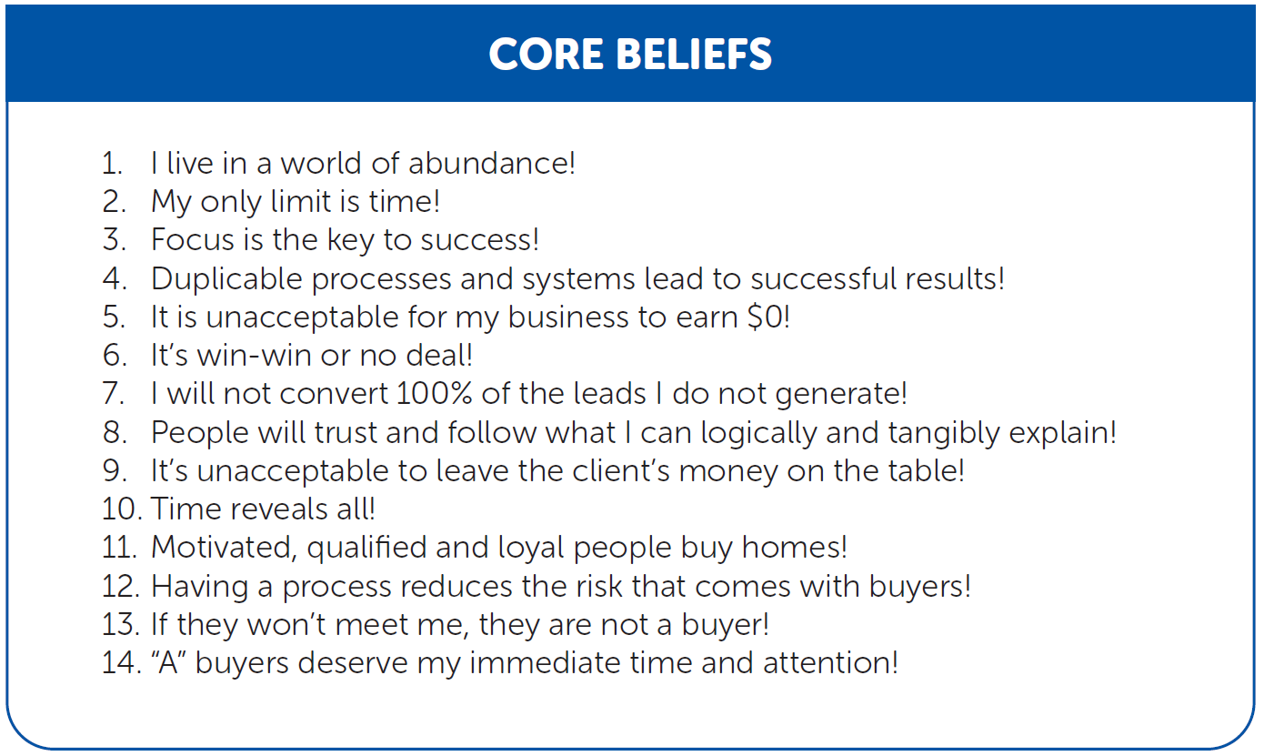
GETTING ON THE VIDEO CHANNEL
The following beliefs are most important within BUYER CONVERSION:

Slide 64
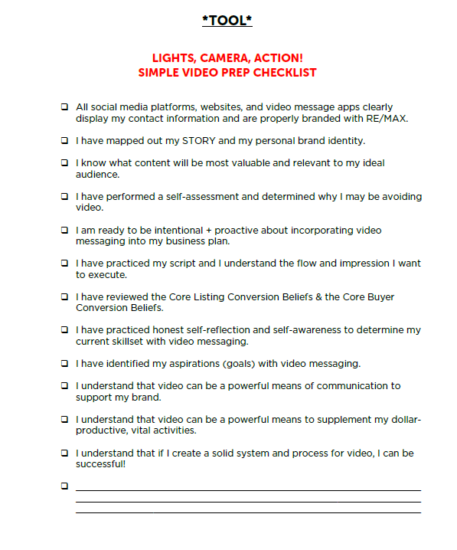
*TOOL*

Slide 65
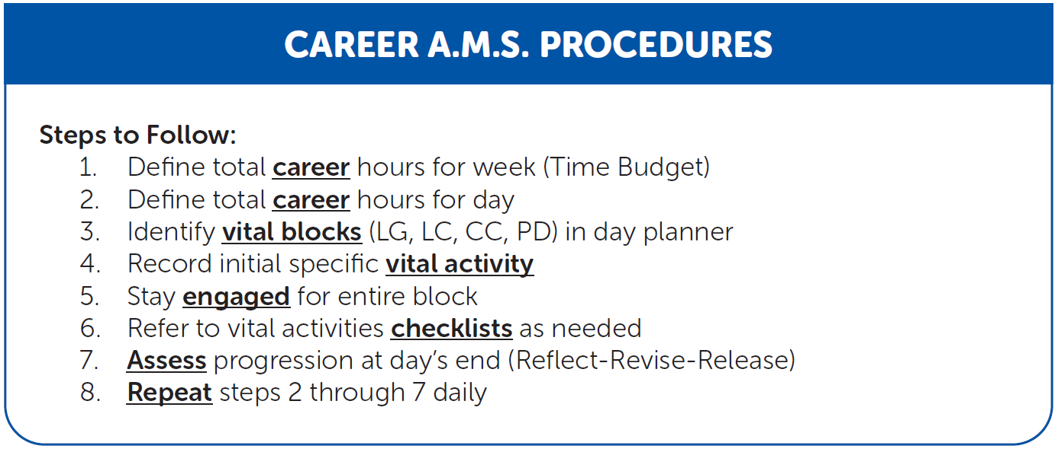
YOUR SYSTEM & SCHEDULE
Creating a system or schedule based on your success habits, requires an intentional + proactive mindset!
The goal is to maximize output by making 100% of your workday vital.
Notes:
REFERENCE
“Activities Management” Agent Training course within the Momentum 1.0 18 Core Agent Development Courses

Slide 66
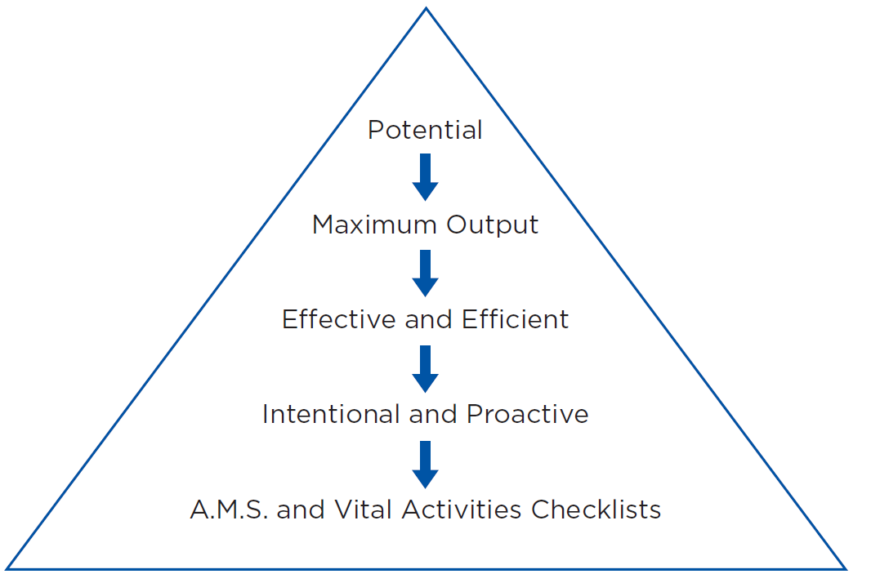
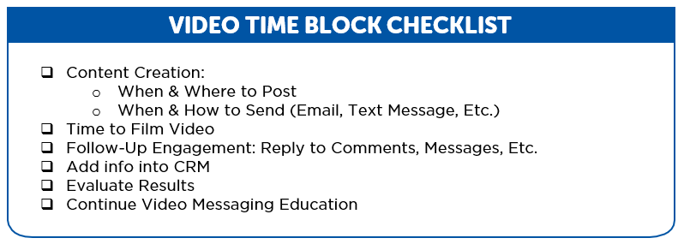

YOUR SYSTEM & SCHEDULE
Notes:
REFERENCE
“Activities Management” Agent Training course within the Momentum 1.0 18 Core Agent Development Courses

Slide 67
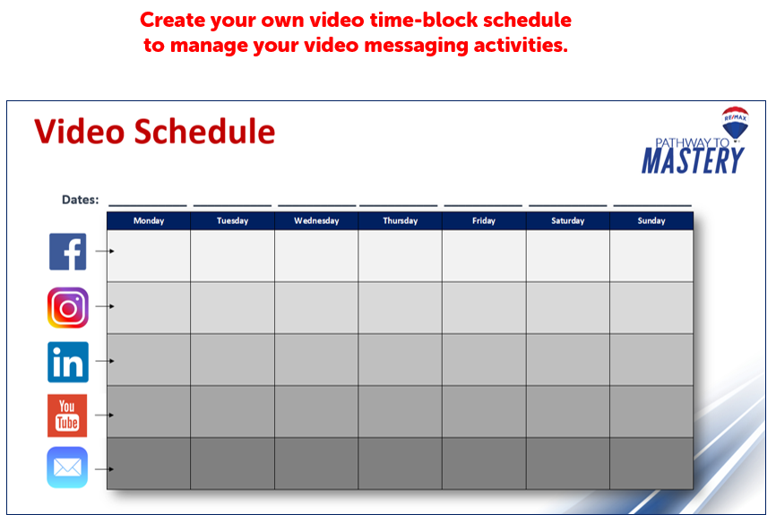
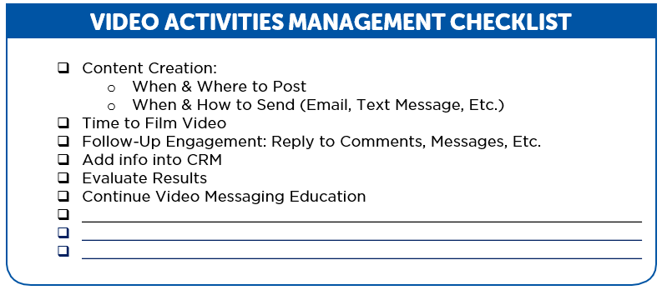
*TOOL*
Create your own video time-block schedule
to manage your video messaging activities.

Slide 68
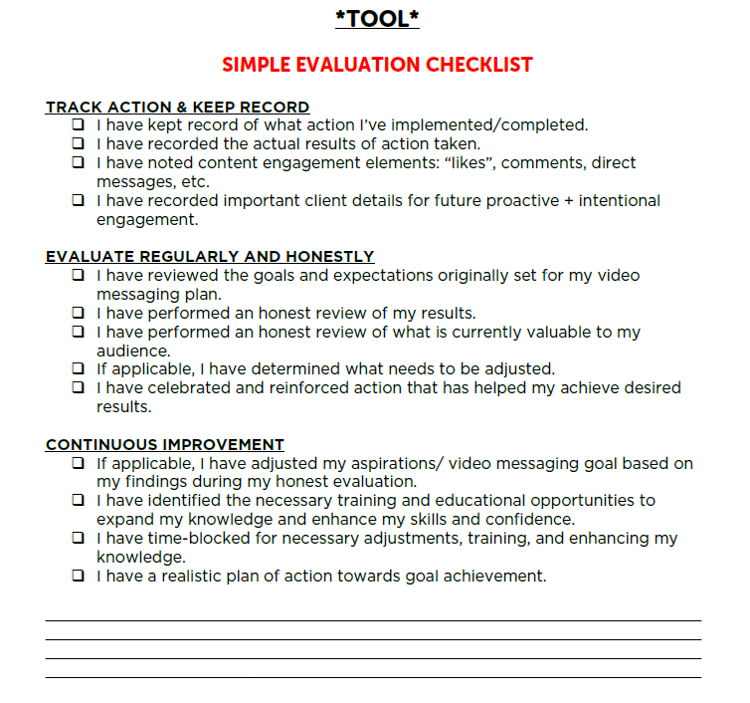
CONTINUOUS IMPROVEMENT
*TOOL*

Slide 69
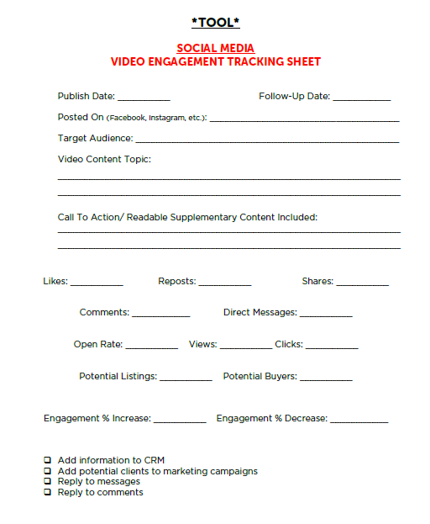
*TOOL*

Slide 70
The goal of training is always ACTION!
“When you’re in motion, you’re planning and strategizing and learning. Those are all good things, but they don’t produce a result.
Action, on the other hand, is the type of behavior
that will deliver an outcome...
You don’t want to merely be planning.
You want to be practicing.”
James Clear, Atomic Habits

Slide 71
THANK YOU!

