Slide 1
As a reminder, RE/MAX, LLC holds the copyright on all Momentum Training Materials. Do not distribute this PowerPoint presentation or any other Momentum Materials beyond your office. Please take time to read the additional information below regarding the use of these materials.
THE PURPOSE OF THE MOMENTUM PROGRAM
As a RE/MAX Affiliate, you’re a member of the most professional, most productive real estate network in the world.
There are many decisions you must make each and every day to run a successful business. The Momentum program provides basic information to help you. Please note: The Momentum program and materials are designed as a resource to reference.
The suggestions made within are not mandatory.
FOR ILLUSTRATION ONLY
Certain sections of the Momentum materials illustrate how making changes to numbers, such as for costs and expenses, can ﬁnancially impact an agent’s business. These sections are meant to be illustrations only and are not intended to be an exhaustive list of costs that may impact your business or to be speciﬁc to your situation. RE/MAX, LLC makes no promises, representations or guarantees of any kind about the success or proﬁtability of your operations.
CONFIDENTIALITY AND RESTRICTIONS ON USE
Momentum materials, including the attached files, are for use by RE/MAX Affiliates only. Momentum materials, including the attached files, are the confidential property of RE/MAX, LLC. Any possession is considered to be a loan of assets and trade secrets, and the materials must be returned to RE/MAX, LLC should recipient’s association with RE/MAX terminate.
TRADEMARKS AND REGULATIONS
In communicating your affiliation with RE/MAX in person, online or through promotional materials, please reference the RE/MAX Brand Identity: Trademark and Graphics Standards guide to ensure proper use of the RE/MAX name and marks.
Whenever you engage in telemarketing (including marketing via text messaging) or e-mail marketing, ensure that your marketing complies with all applicable federal, state and provincial laws and regulations, including the CAN-SPAM Act, the Telephone Consumer Protection Act, and the Telemarketing Sales Rule. RE/MAX Affiliates are not permitted to use the RE/MAX marks in connection with any of the following marketing methods: pre-recorded telemarketing messages, auto-dialed telemarketing calls or auto-dialed marketing texts to mobile devices, or unsolicited marketing facsimiles. Moreover, other forms of manually dialed telemarketing calls and the use of marketing emails must also comply with federal and state laws if the RE/MAX marks are in use.
When cold calling, be aware of the requirements of the national (and, if applicable, state) Do Not Call Registry before placing calls. Additionally, be aware of federal and state laws regarding calling consumers before 8 a.m. or after 9 p.m.
RE/MAX offices are independently owned and operated.

Slide 2
Buyer Conversion

Slide 3
Course Overview
PURPOSE:
To teach an intentional, proactive and focused approach for helping buyers find and purchase their perfect home.
EXPECTATION:
Upon completing this class you should feel confident enough to enter into working relationships with serious buyers.
RESULT:
9-64 Closing

Slide 4
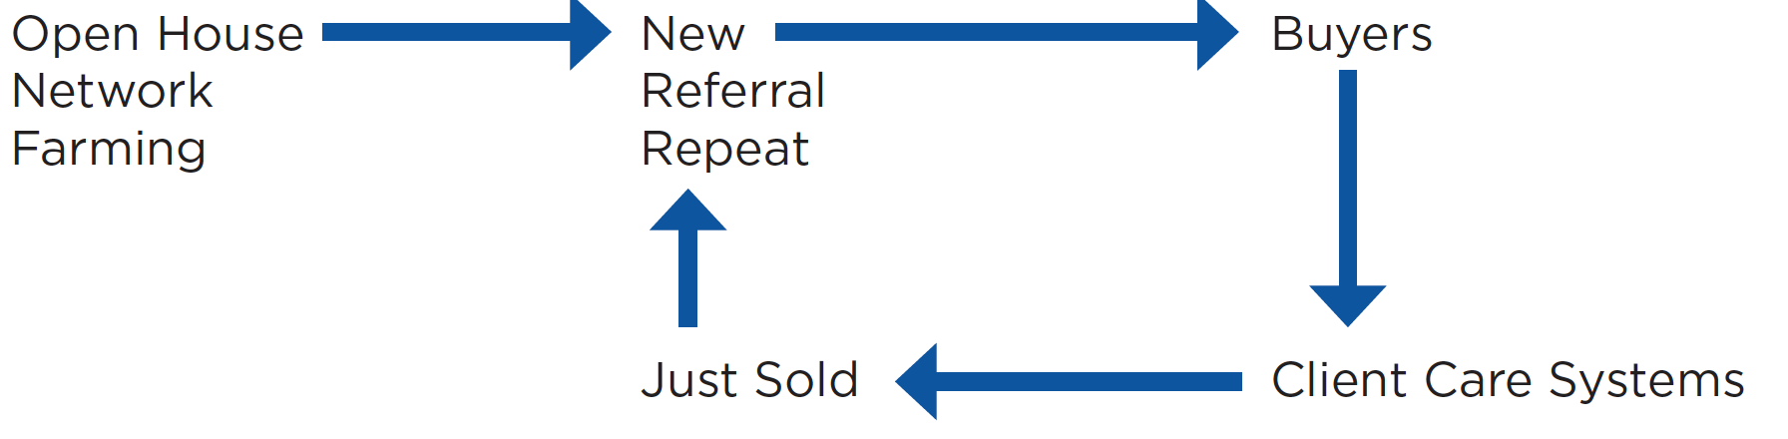
Plan

Slide 5
What Is This Course About?
Buyer Conversion teaches Associates the five stages of effectively working with buyers. You’ll learn to facilitate buyer conversations, identify appropriate properties, prepare showing packages, show homes, overcome common buyer hesitations and close sales. This class is designed to turn a typical agent into a highly respected and sought-after buyer’s consultant. Plans, scripts and tools are provided.

Slide 6
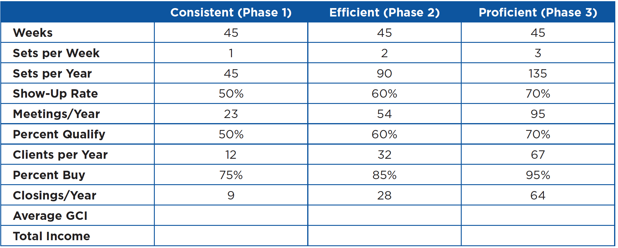
The Financial Security Of An Effective Lead Converter

Slide 7
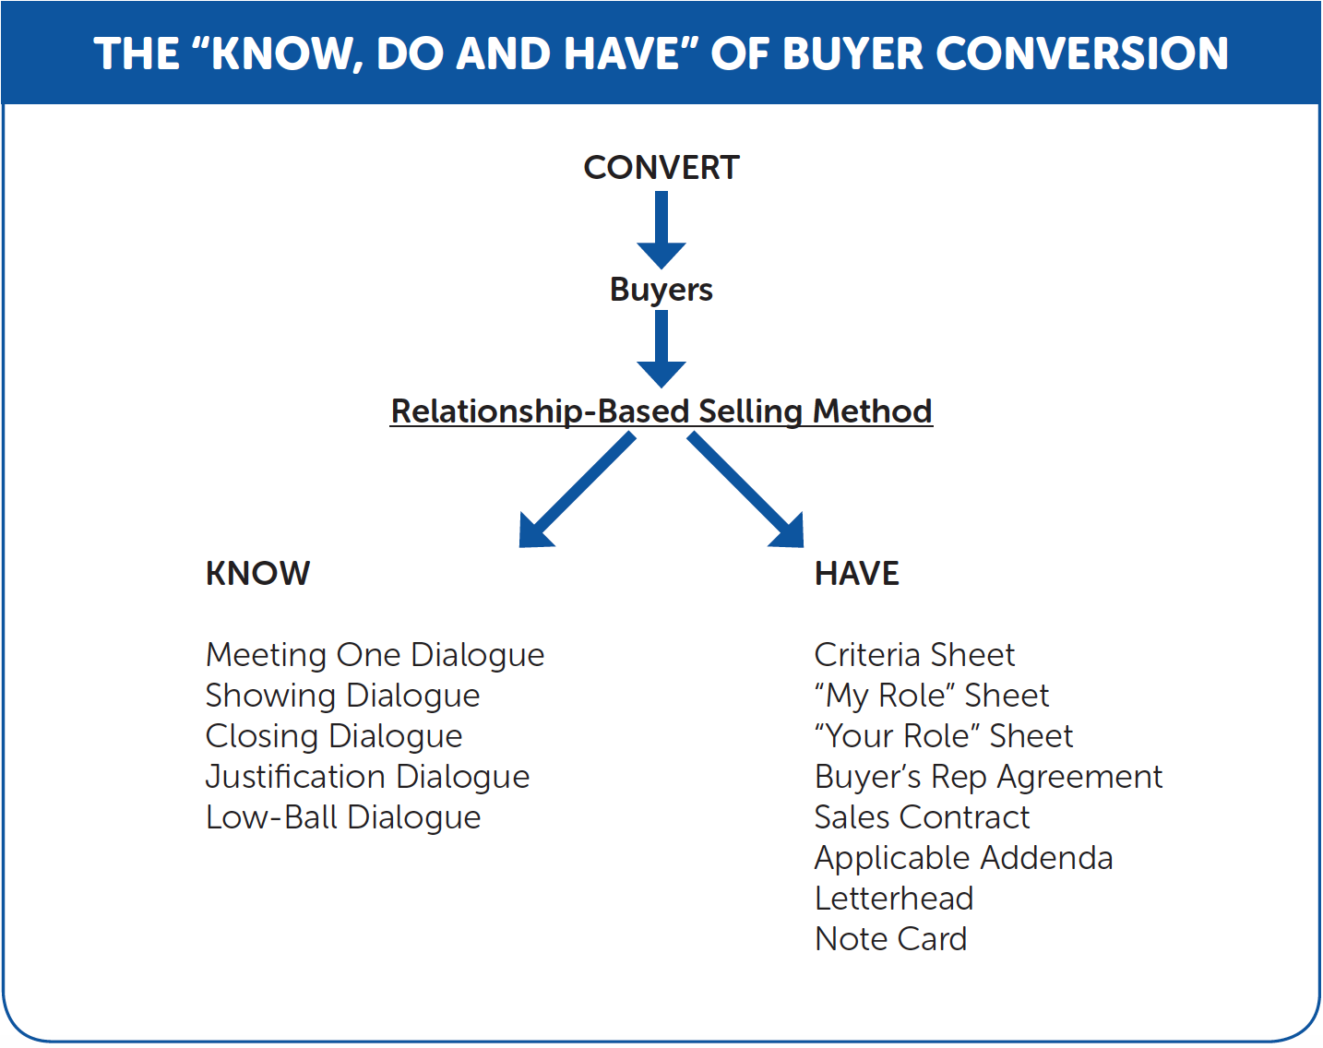
Buyer Conversion Plan

Slide 8
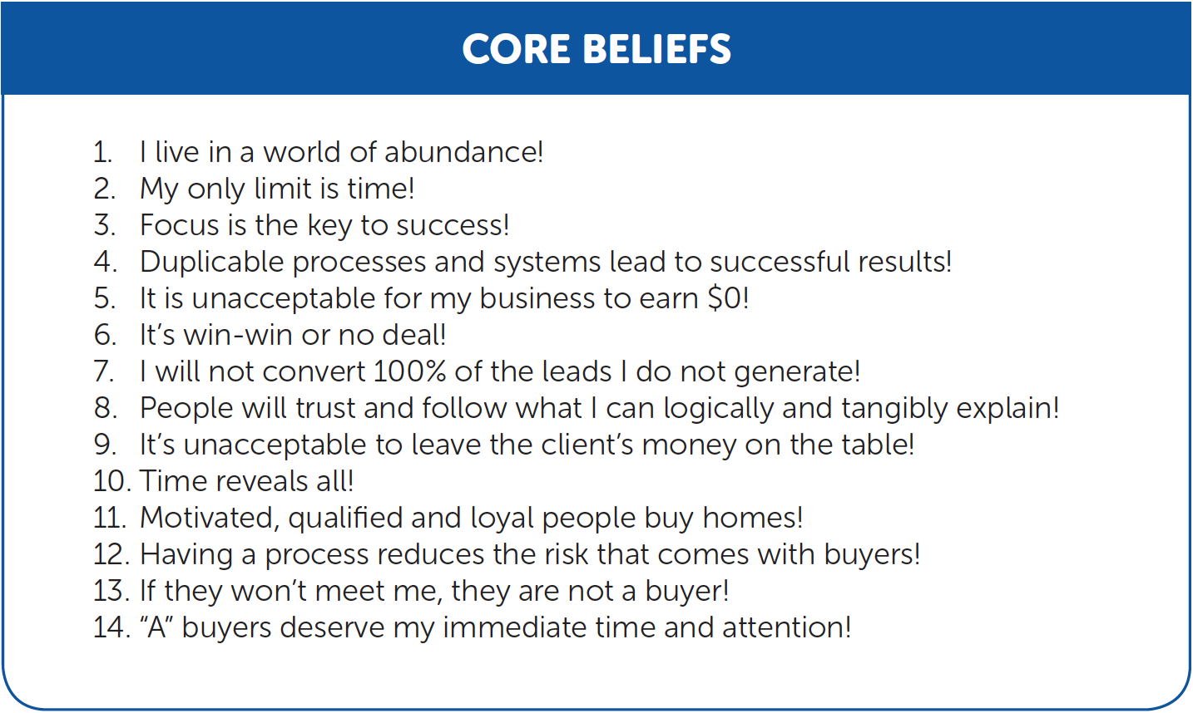
Check Your Attitude

Slide 9
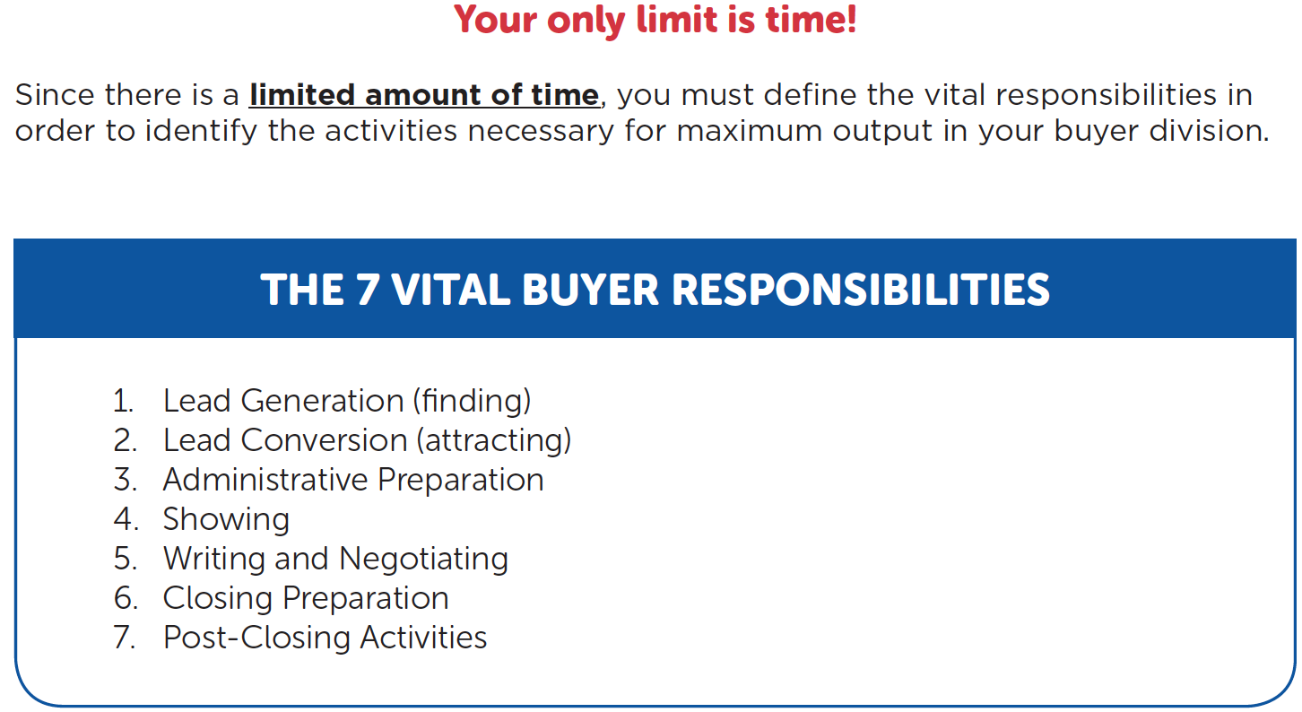
The 7 Vital Buyer Responsibilities

Slide 10
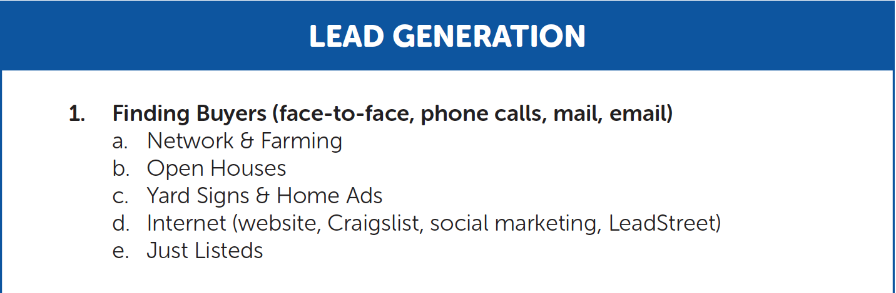
47 Vital Buyer Activities

Slide 11
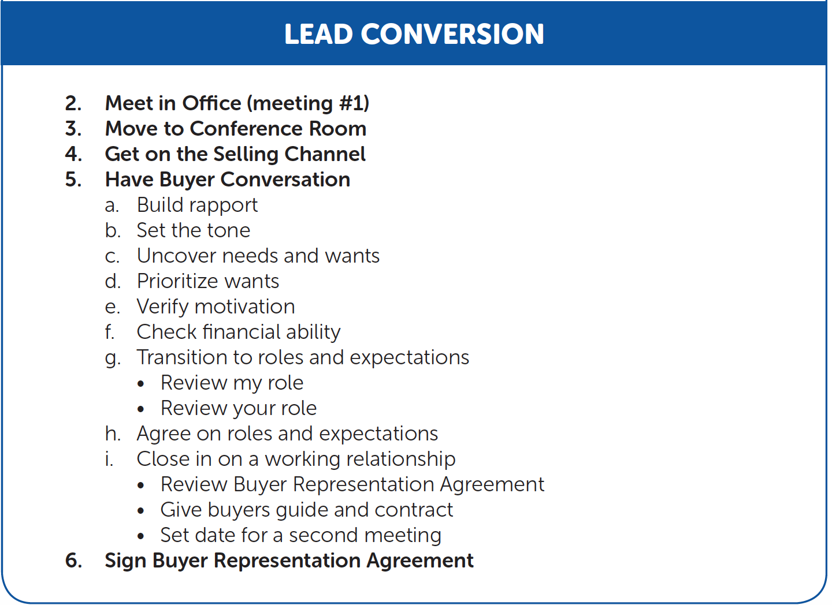
47 Vital Buyer Activities

Slide 12
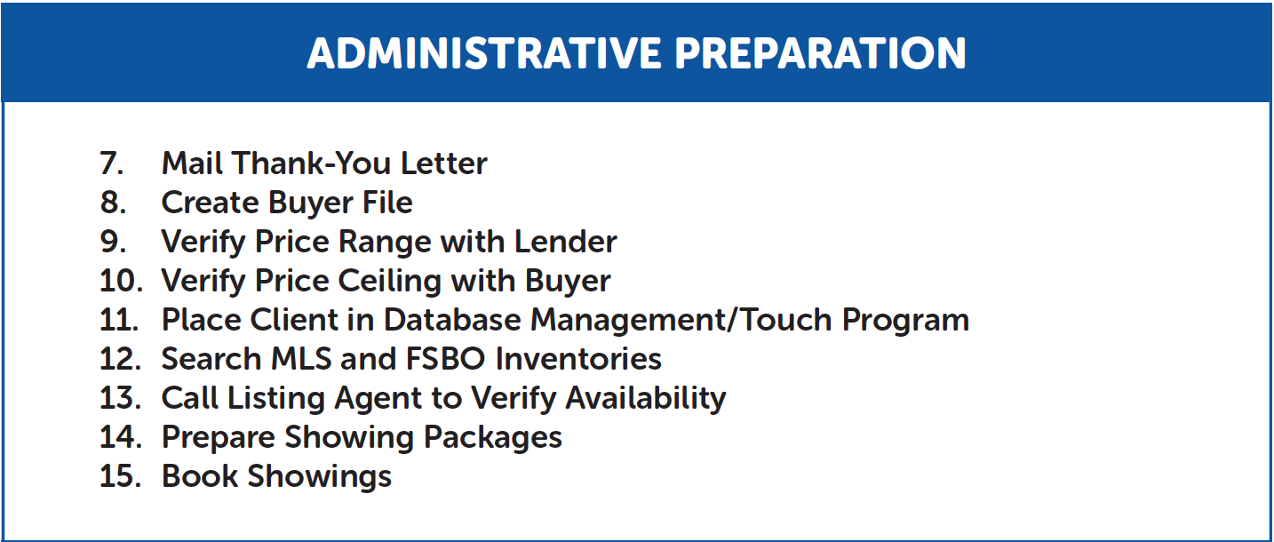
47 Vital Buyer Activities

Slide 13
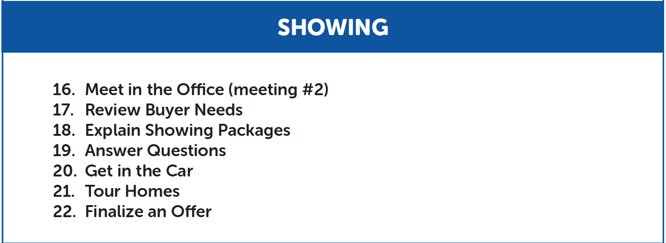
47 Vital Buyer Activities

Slide 14
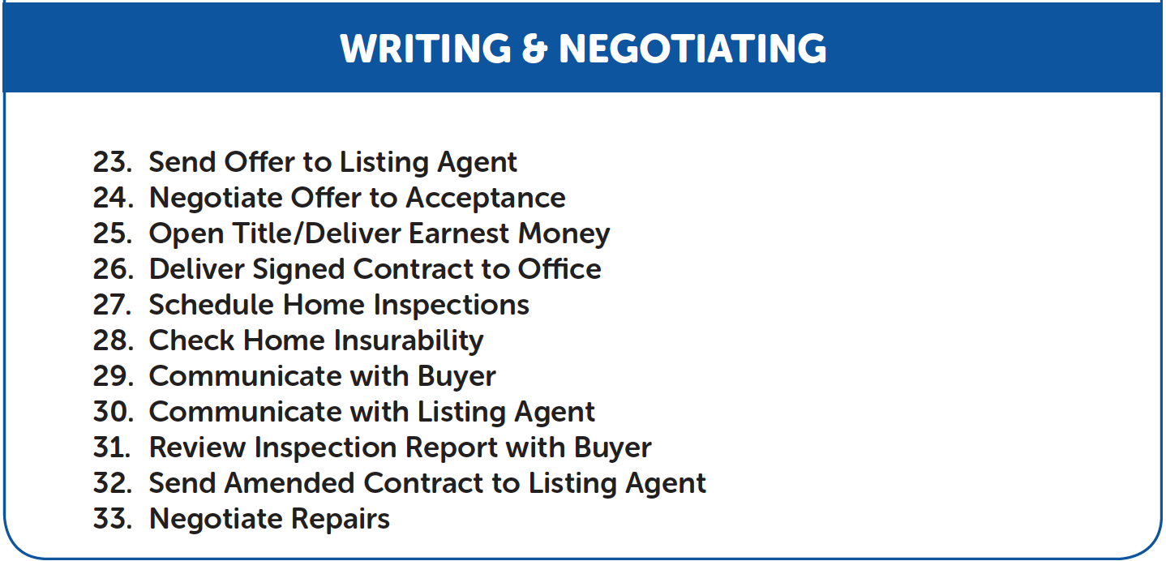
47 Vital Buyer Activities

Slide 15
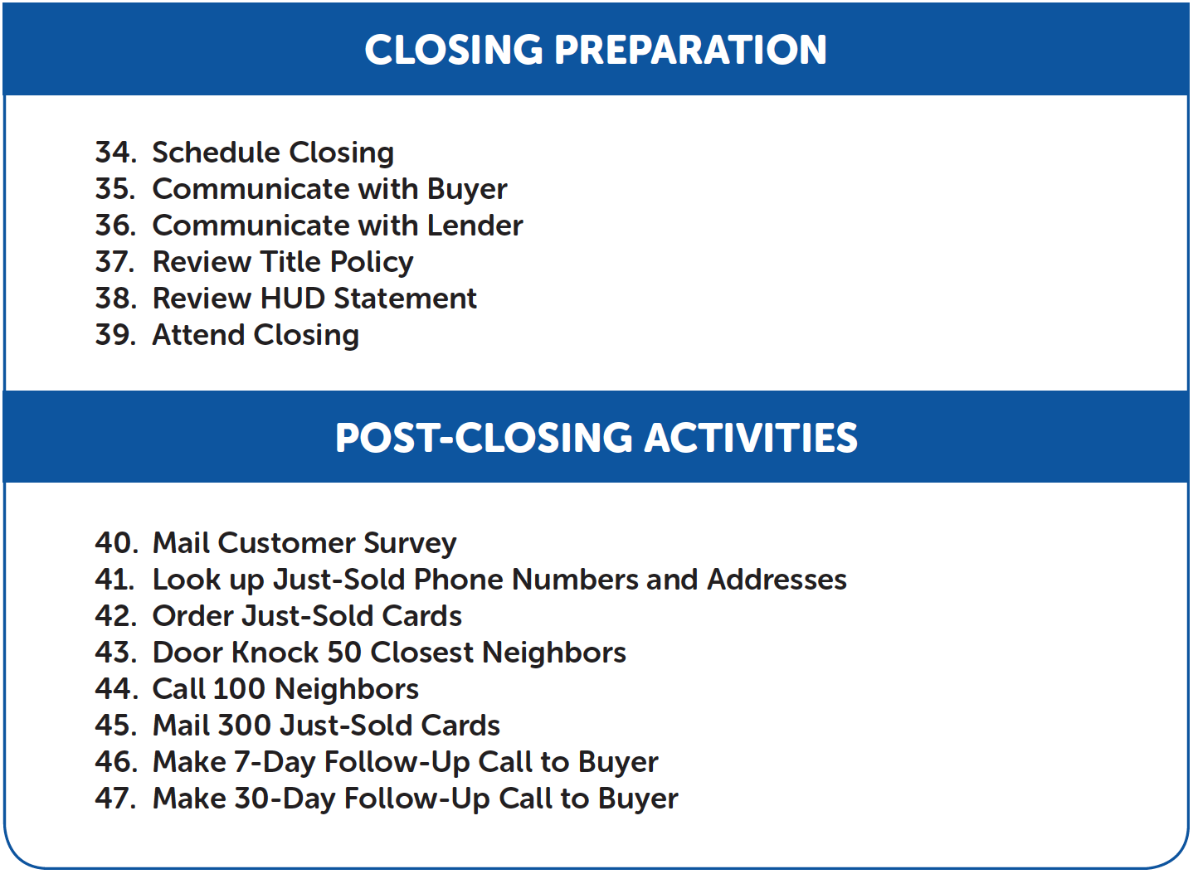
47 Vital Buyer Activities

Slide 16
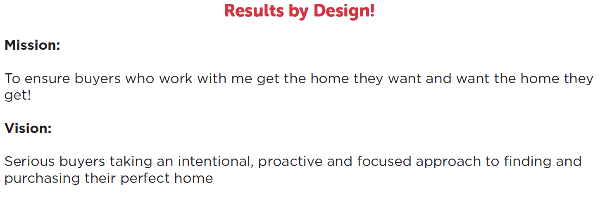

Buyer Department Basics

Slide 17
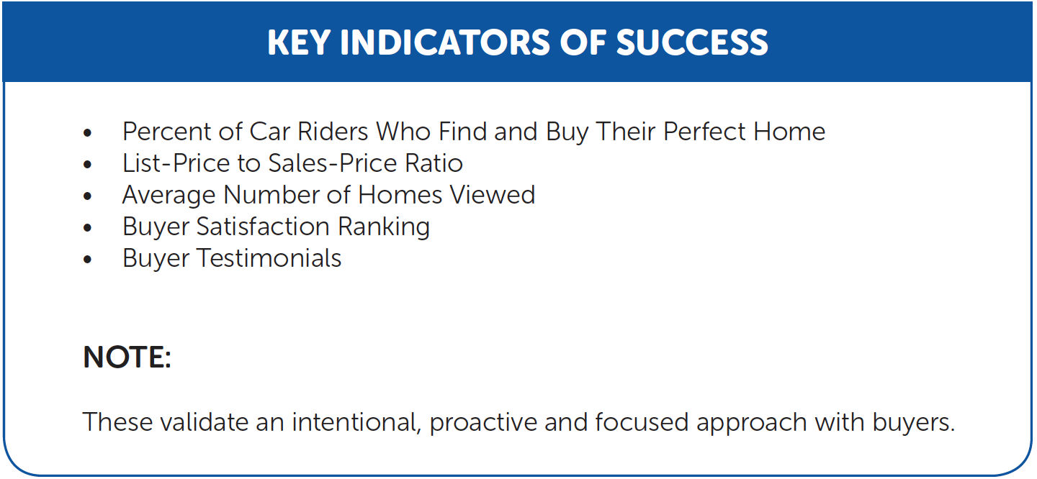
Buyer Department Basics

Slide 18
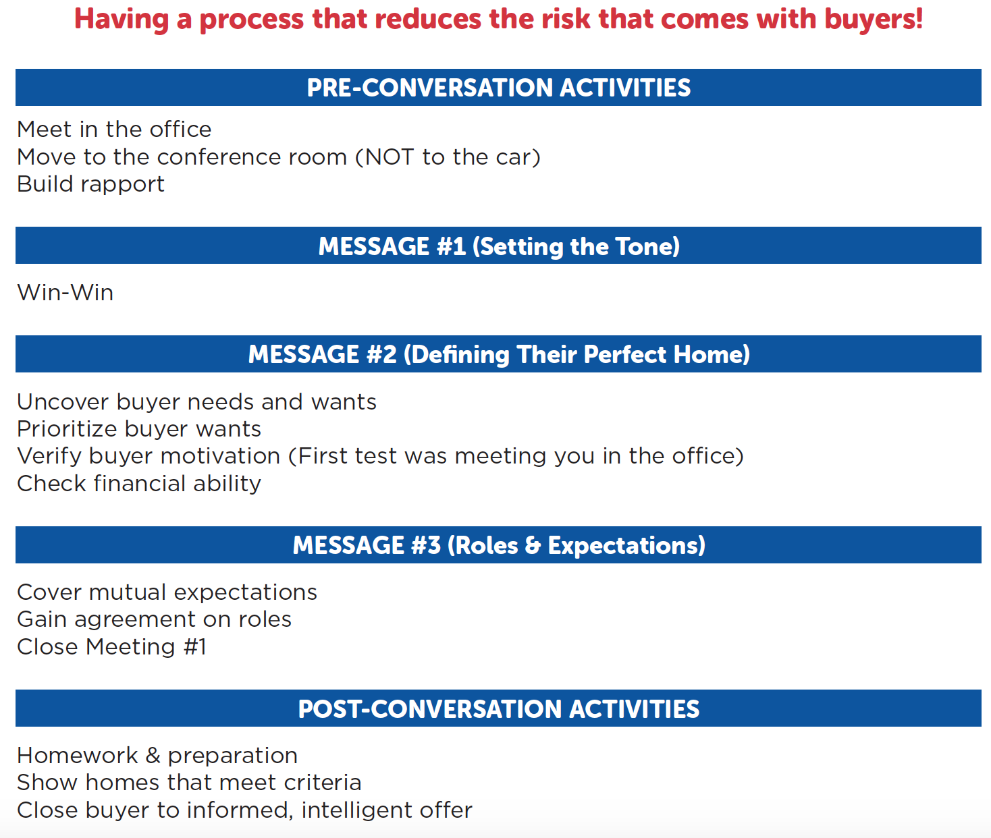
5 Stages Of Working With A Buyer

Slide 19
Meet in the Office!

Slide 20
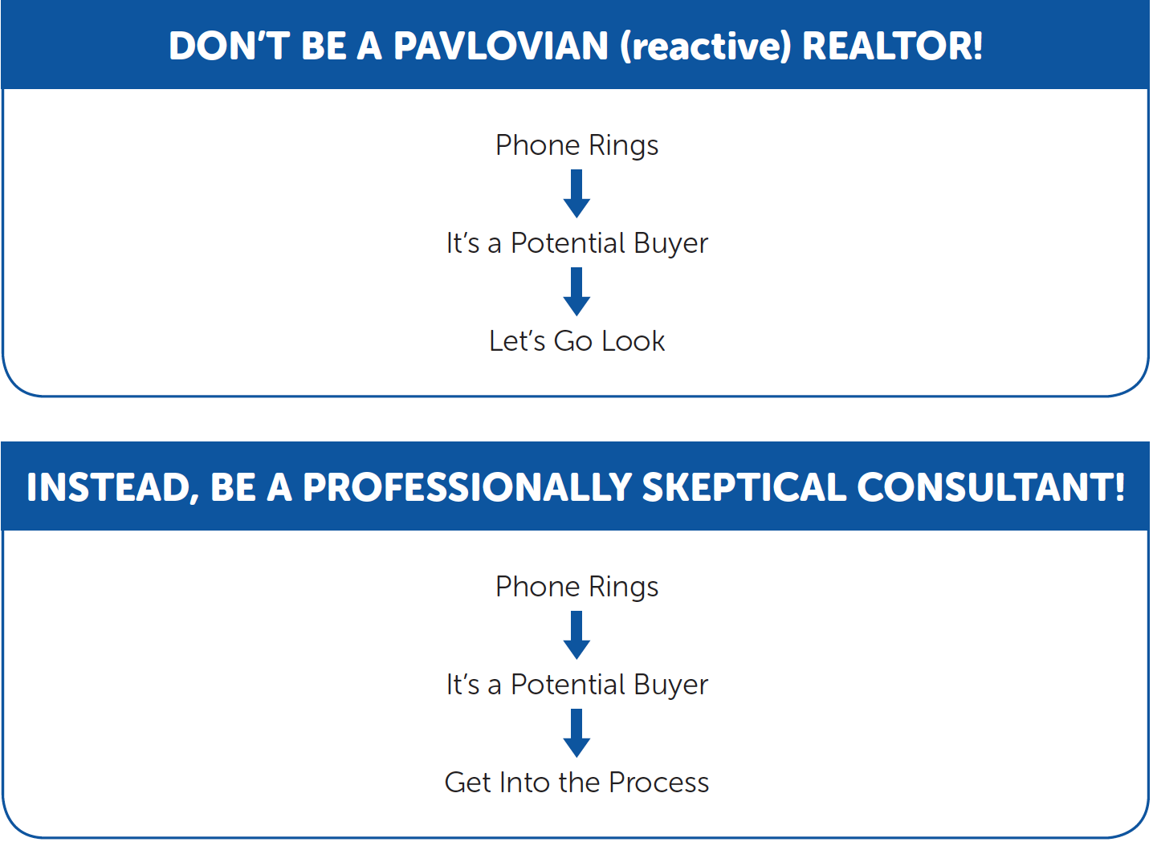

Slide 21
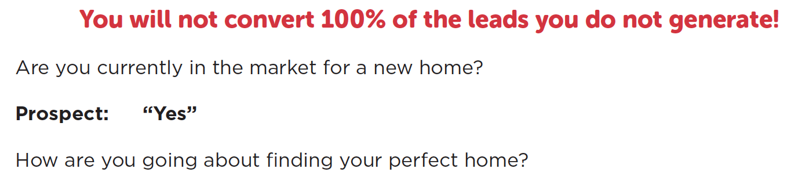
Ask For The Meeting!

Slide 22
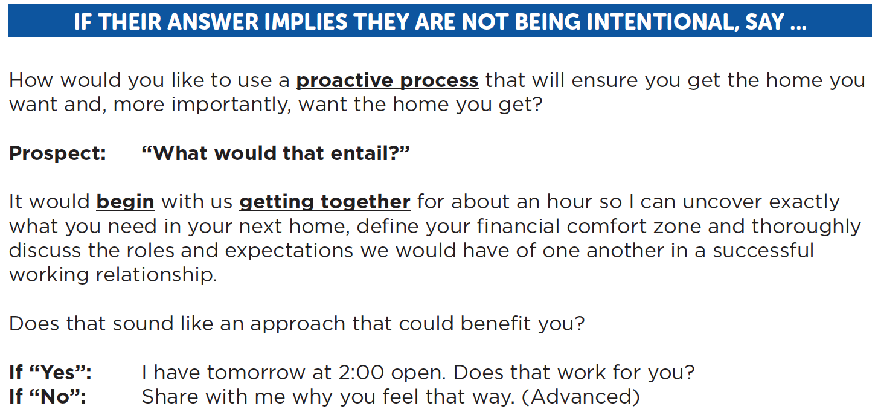
Ask For The Meeting!

Slide 23
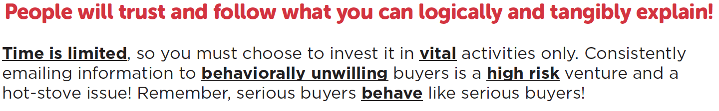
Justify The Meeting!

Slide 24
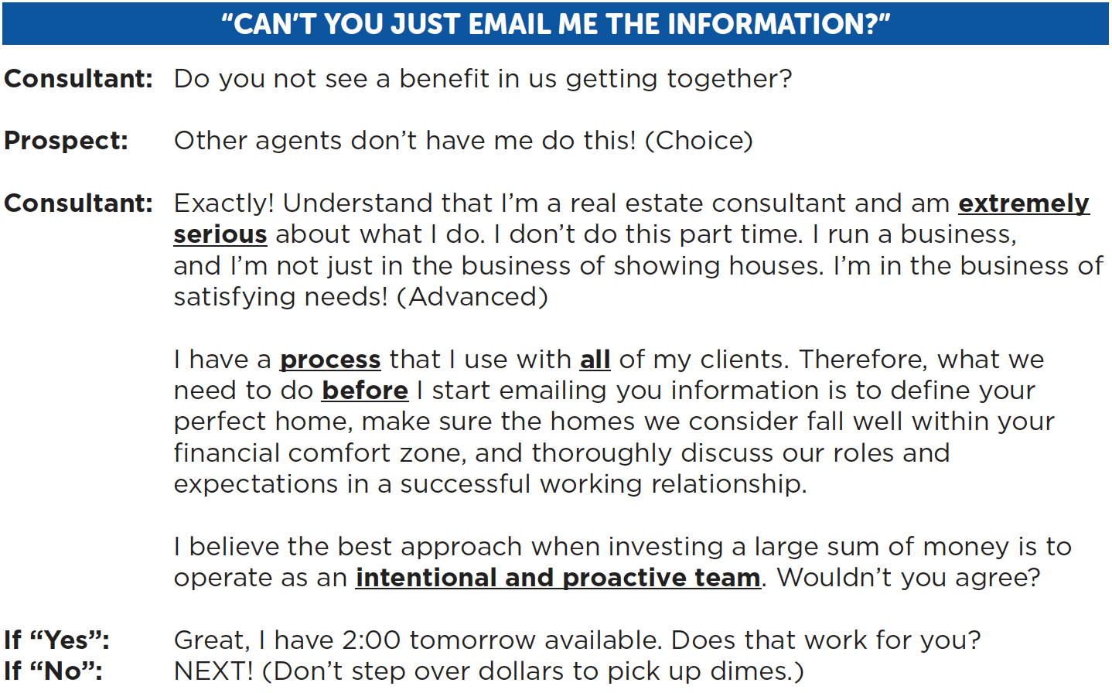
Justify The Meeting!

Slide 25
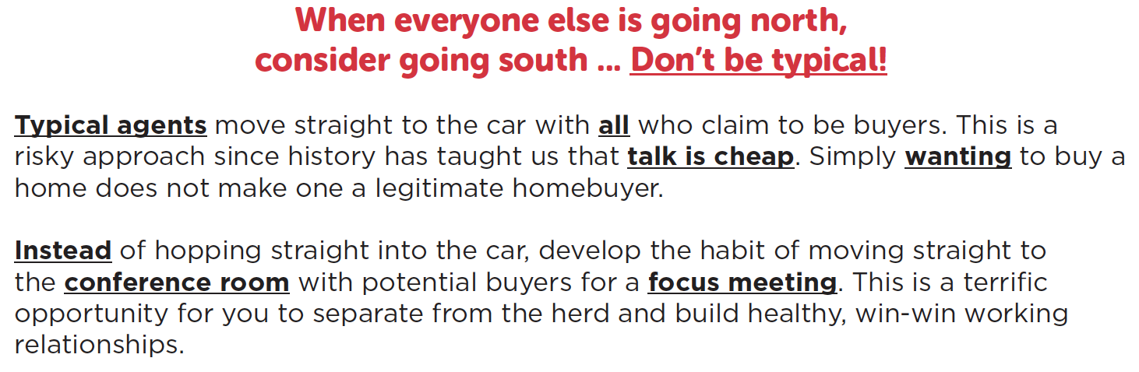
Move To The Conference Room

Slide 26
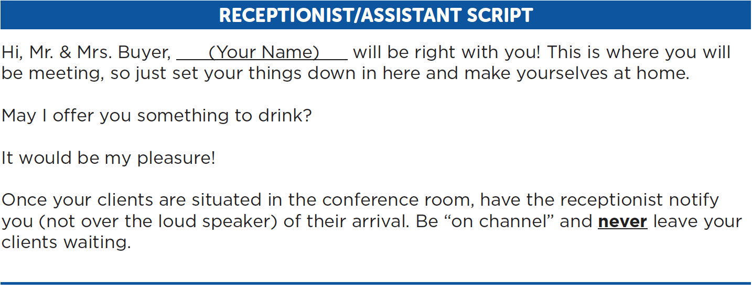
Involve The Receptionist/Assistant

Slide 27

Take Time To Get In The Zone

Slide 28
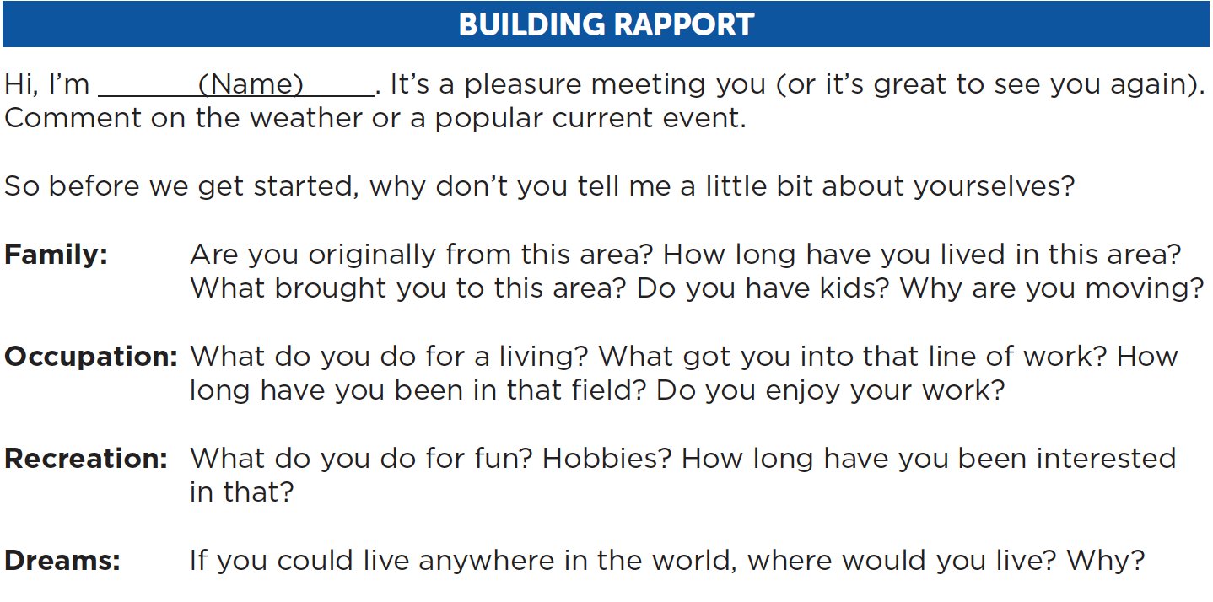
Break The Ice

Slide 29
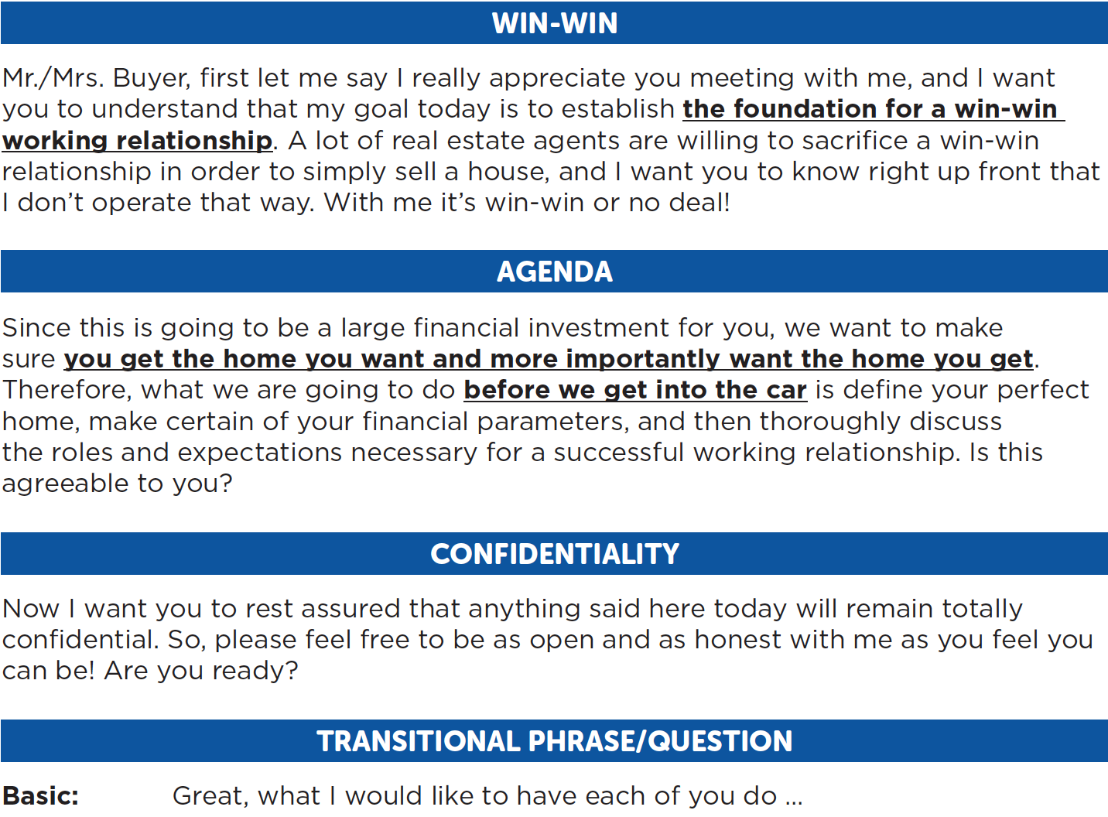
Set The Tone
Stage 2

Slide 30
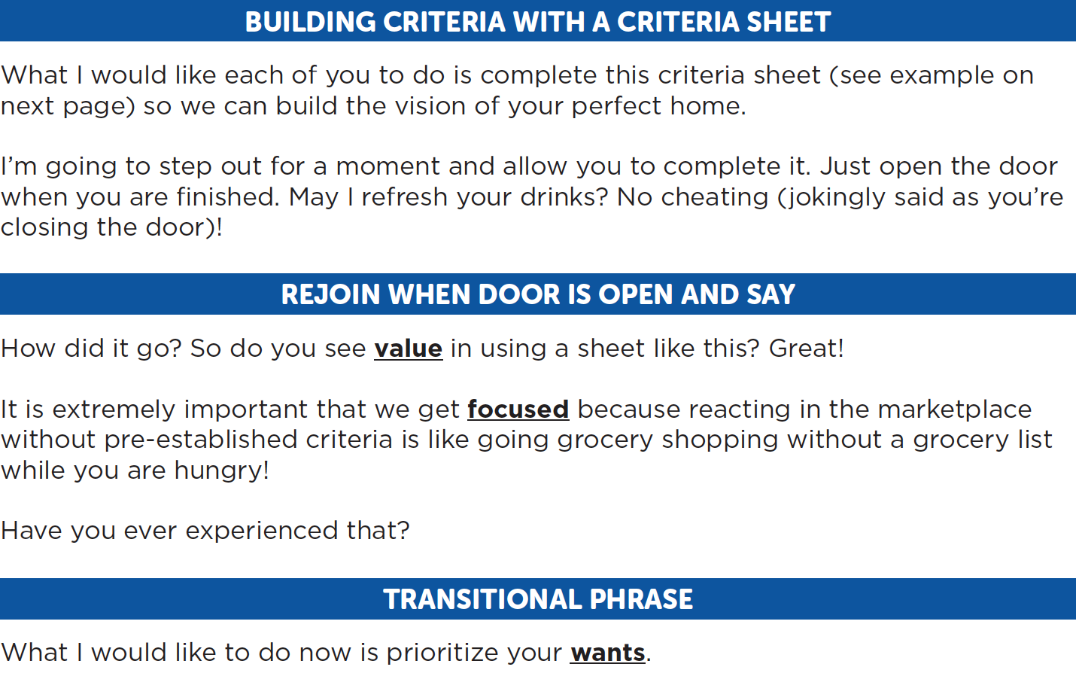
Uncover Buyer Needs & Wants
Stage 3

Slide 31
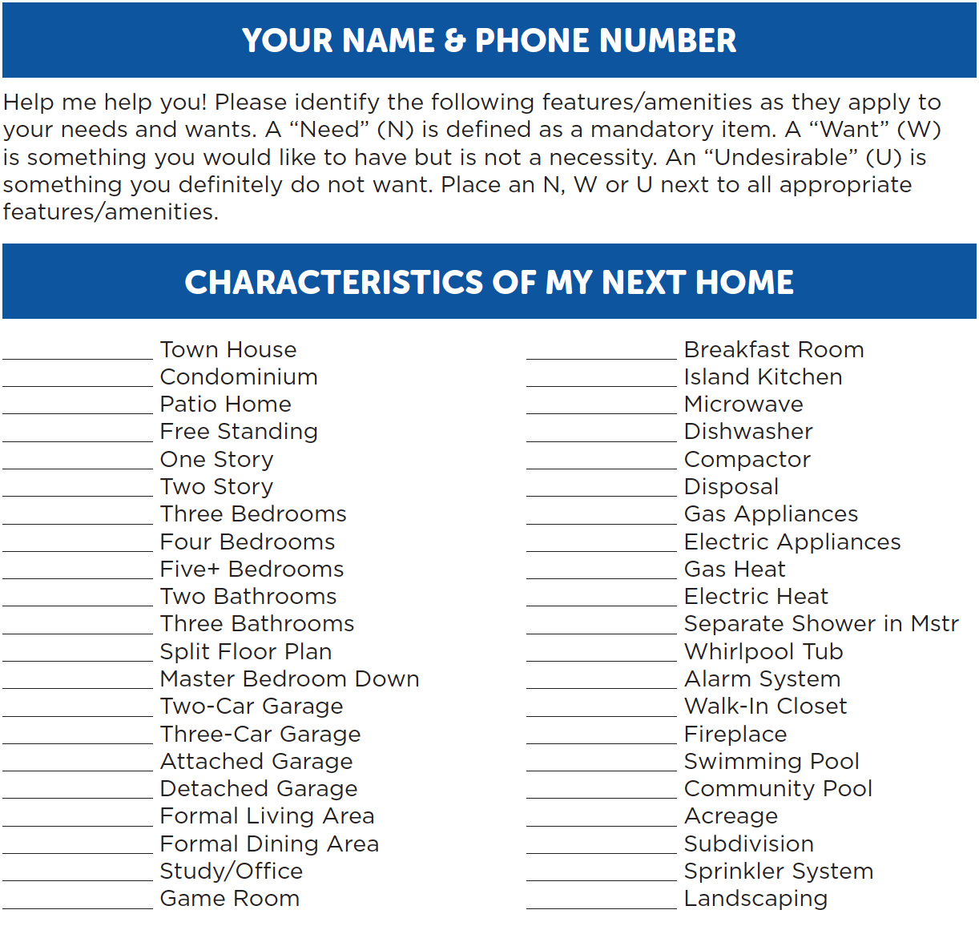
Criteria Sheet
Page 20

Slide 32
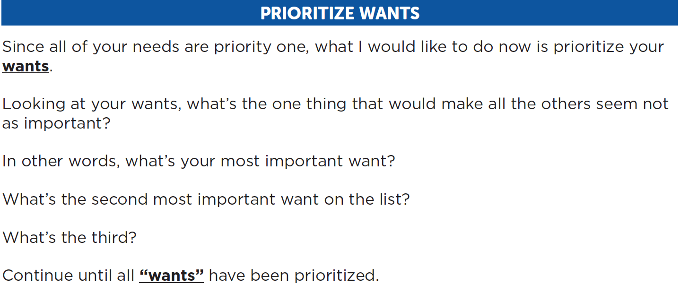
Prioritize Wants

Slide 33
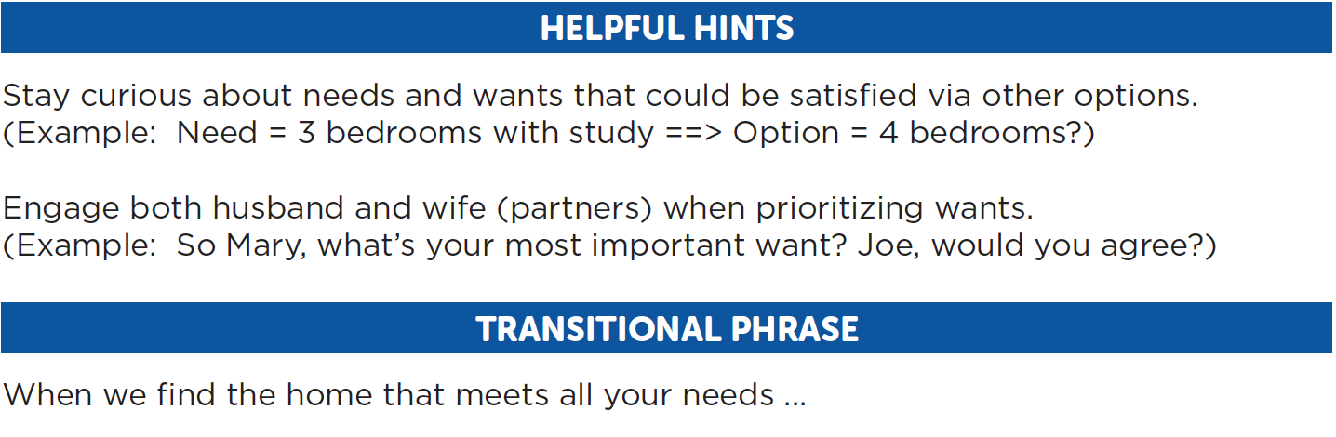
Prioritize Wants

Slide 34
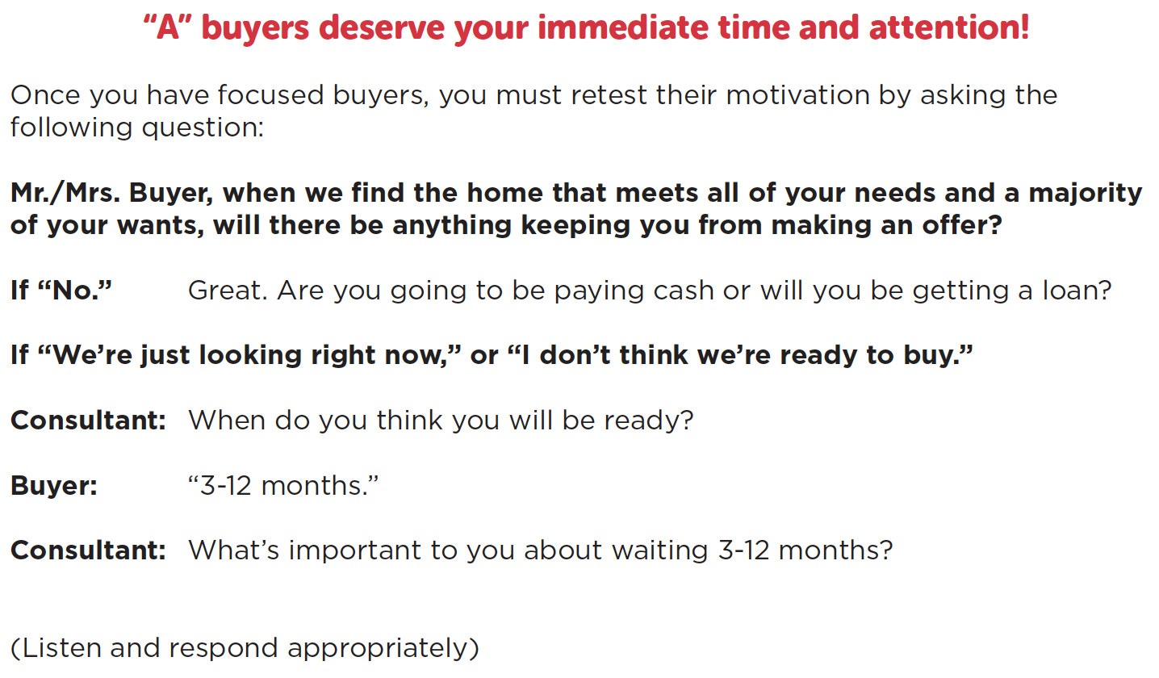
Verify Buyer Motivation

Slide 35
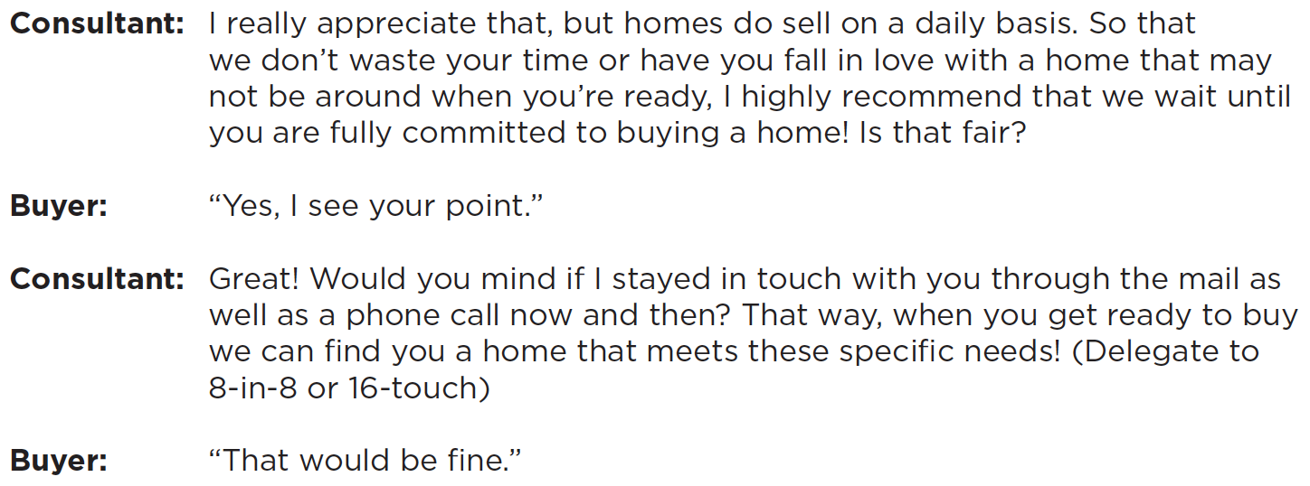
Verify Buyer Motivation

Slide 36
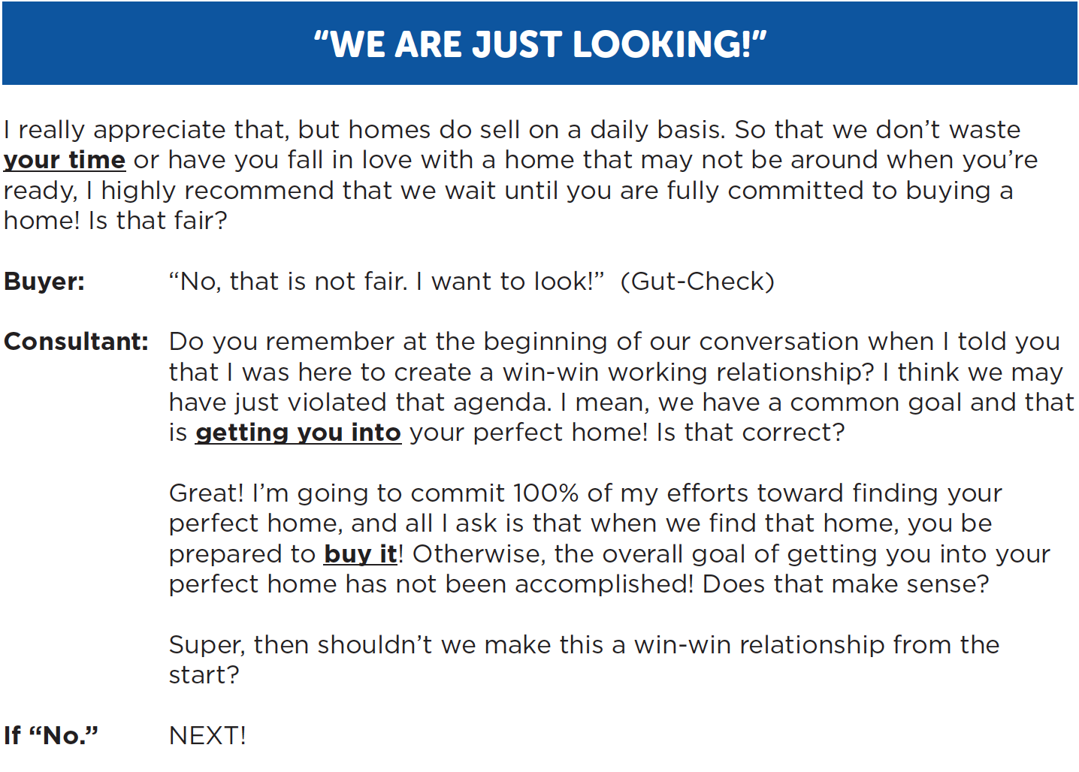
If They Don’t Want To Wait

Slide 37
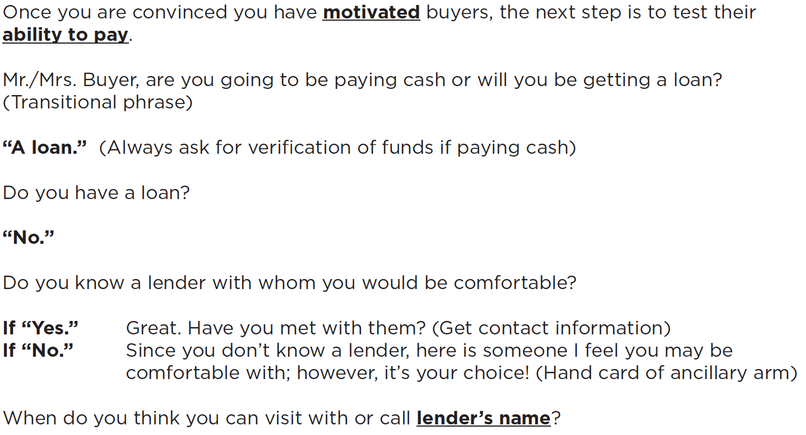
Check Financial Ability

Slide 38
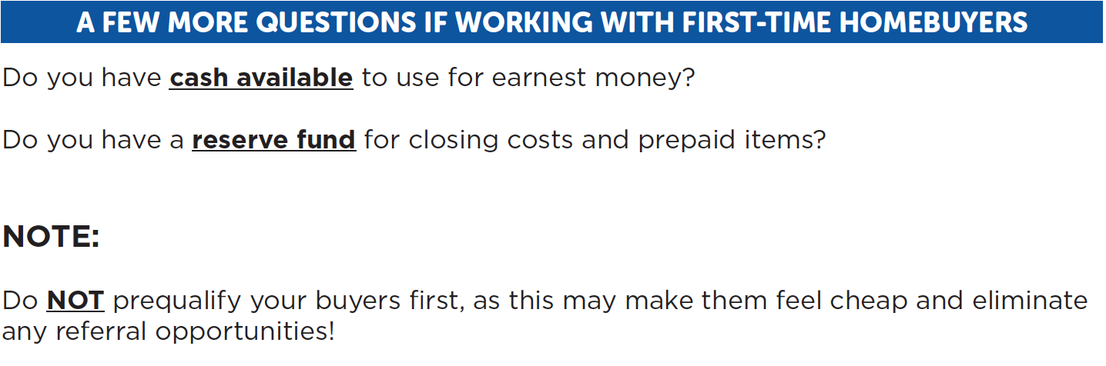
Check Financial Ability

Slide 39
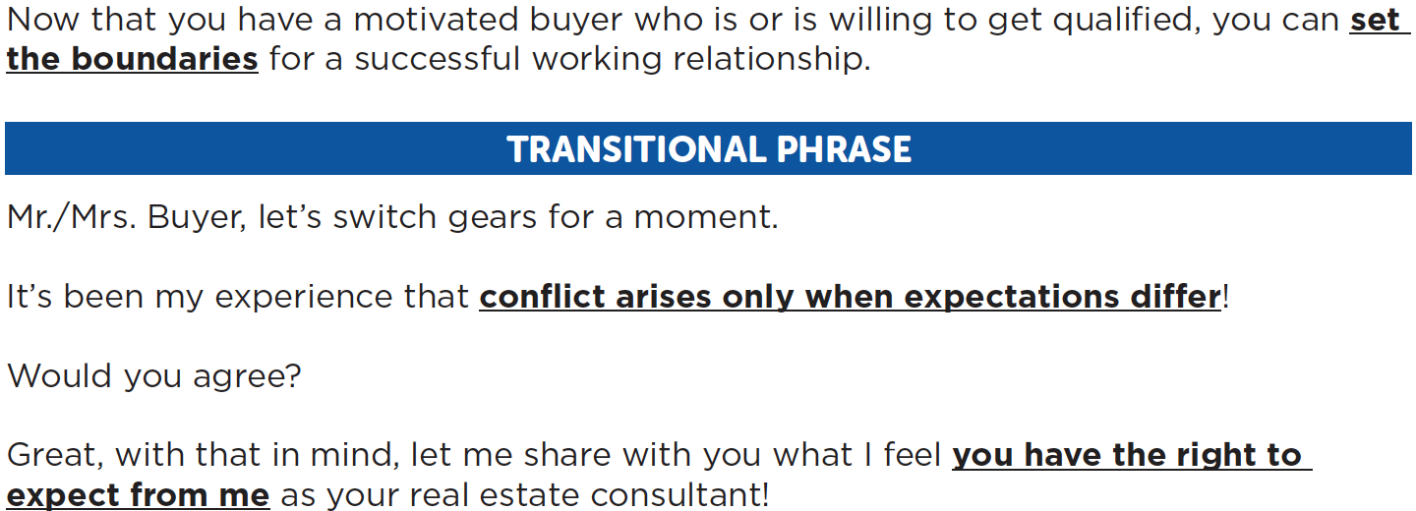
Roles & Expectations
Stage 4

Slide 40
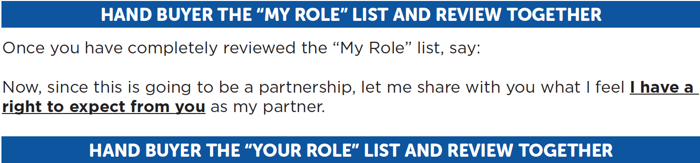
Roles & Expectations

Slide 41
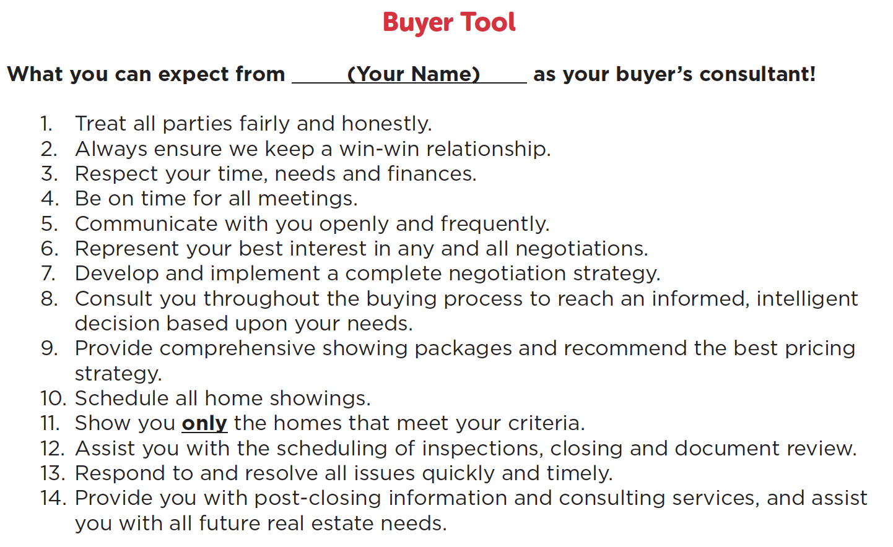
Buyer Tool

Slide 42
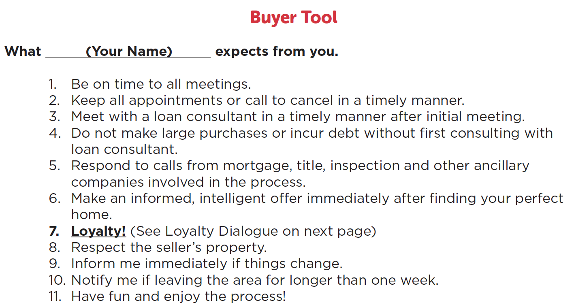
Buyer Tool

Slide 43
Ensure Buyer Loyalty
Only “A” buyers get invited to your car, so you must confirm you are dealing with someone who is loyal!

Slide 44
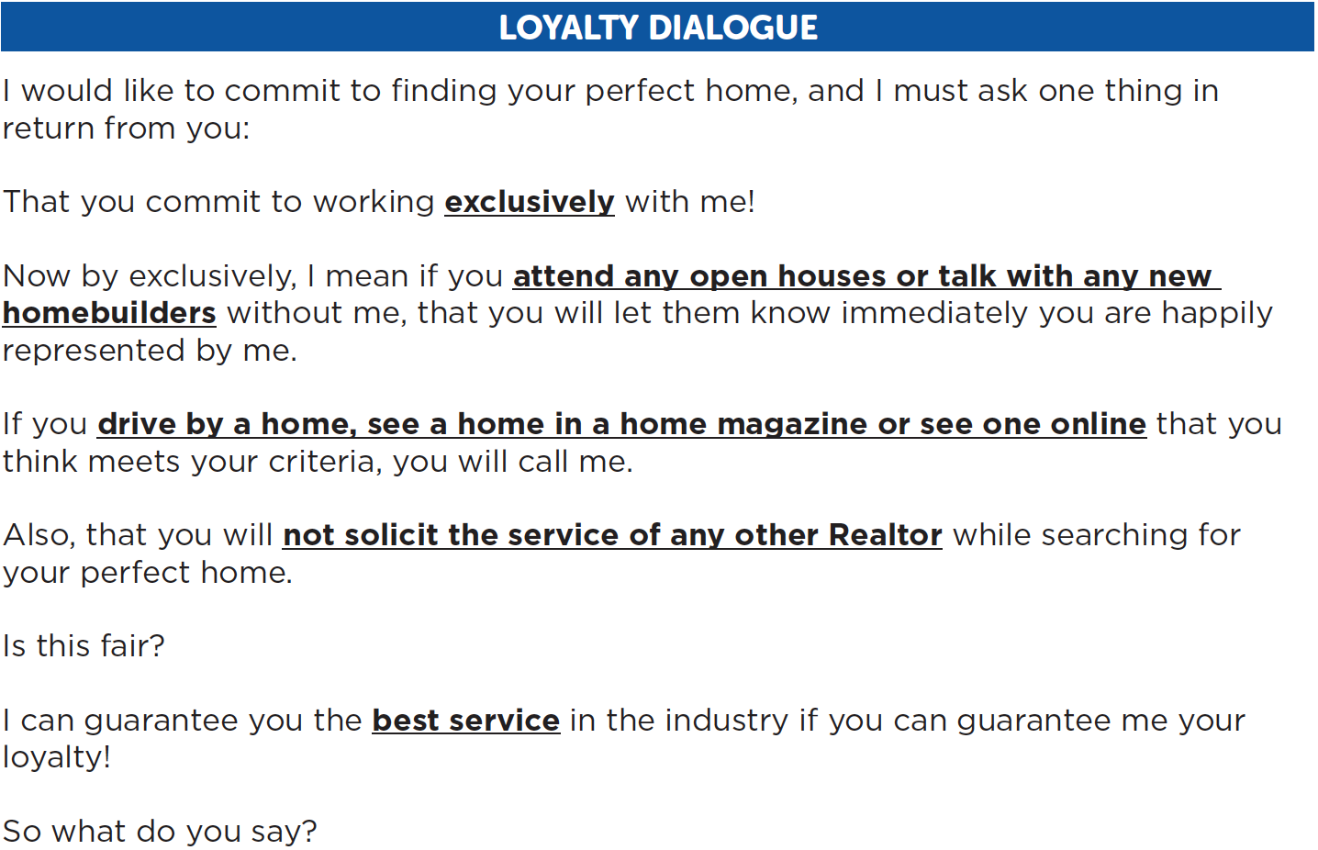
Ensure Buyer Loyalty

Slide 45
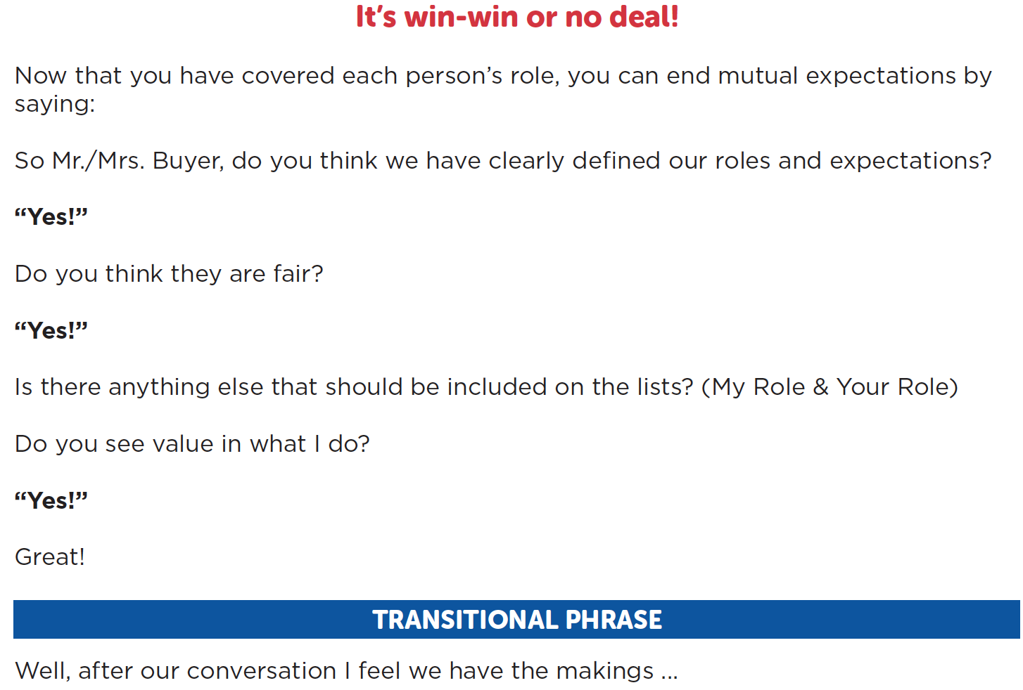
Roles & Expectations

Slide 46
Motivated, qualified and loyal people
buy homes!

Slide 47
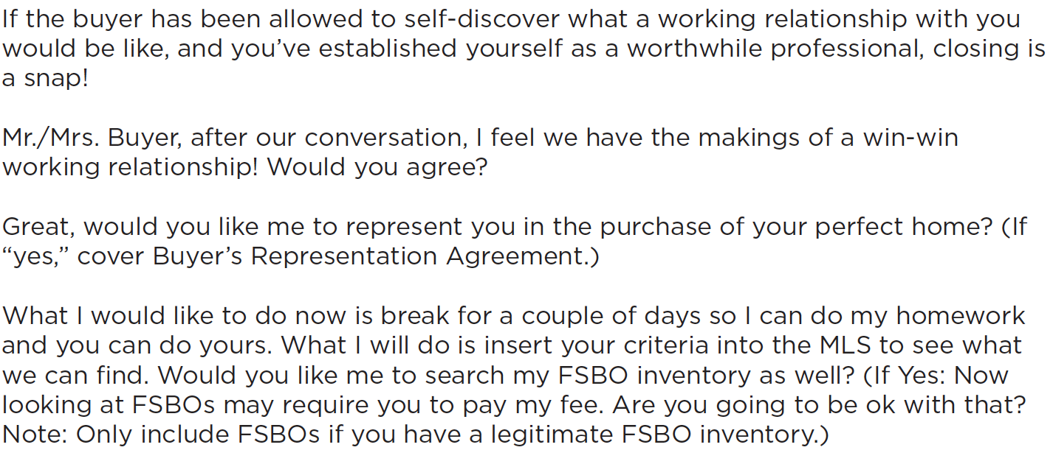
Close Meeting #1

Slide 48
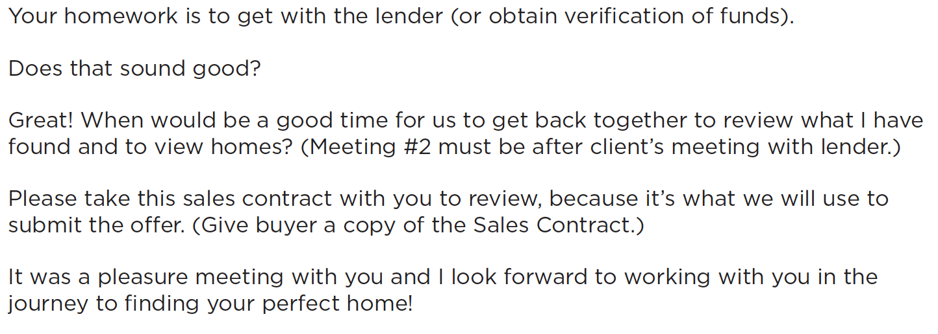
Close Meeting #1

Slide 49
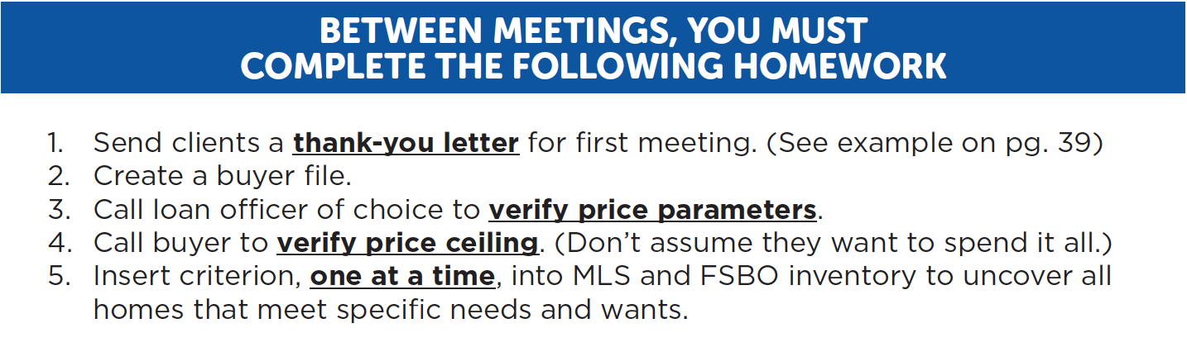
Post-Conversation Activities

Slide 50
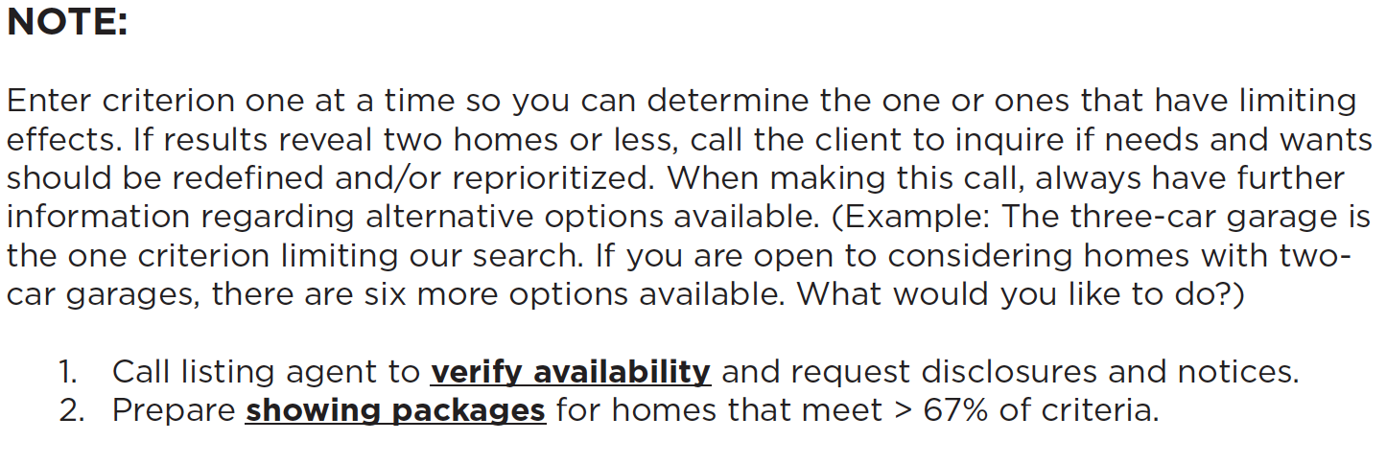
Post-Conversation Activities

Slide 51
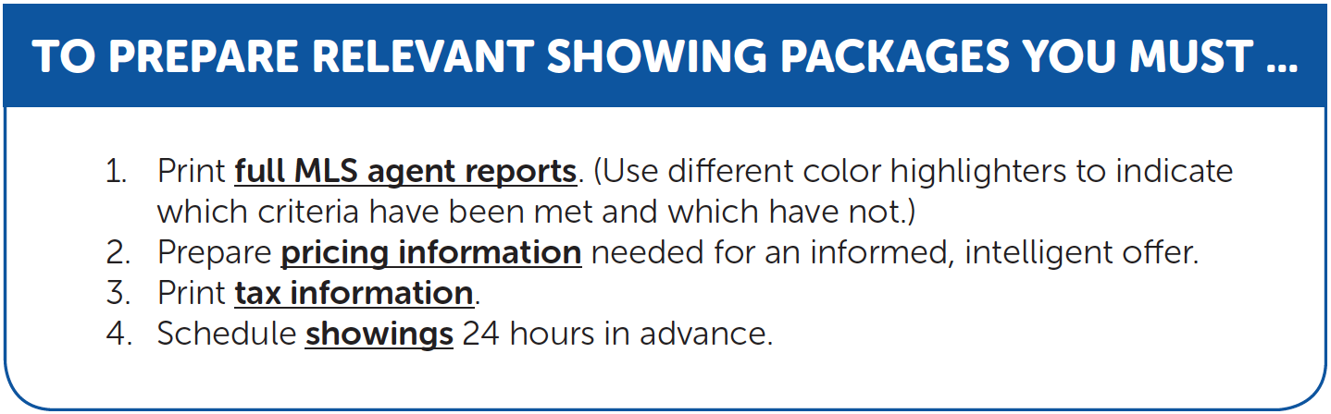
Post-Conversation Activities

Slide 52
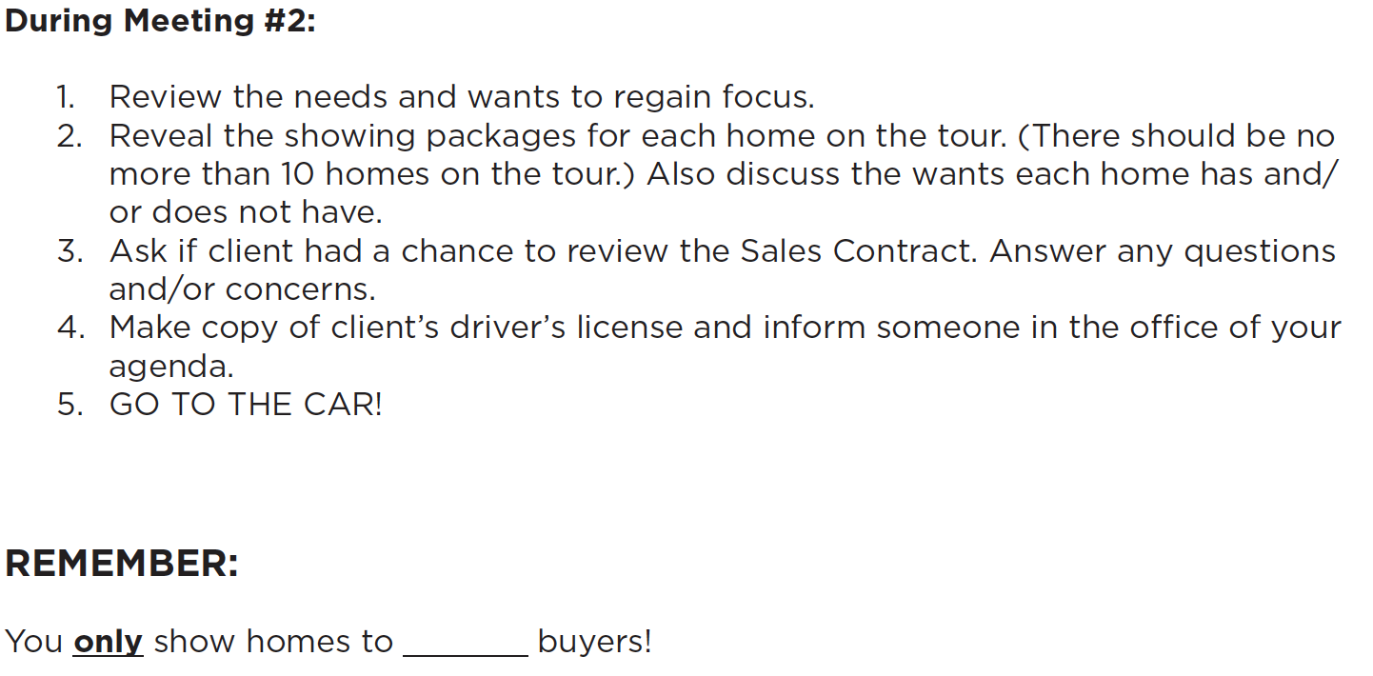
Meeting #2

Slide 53
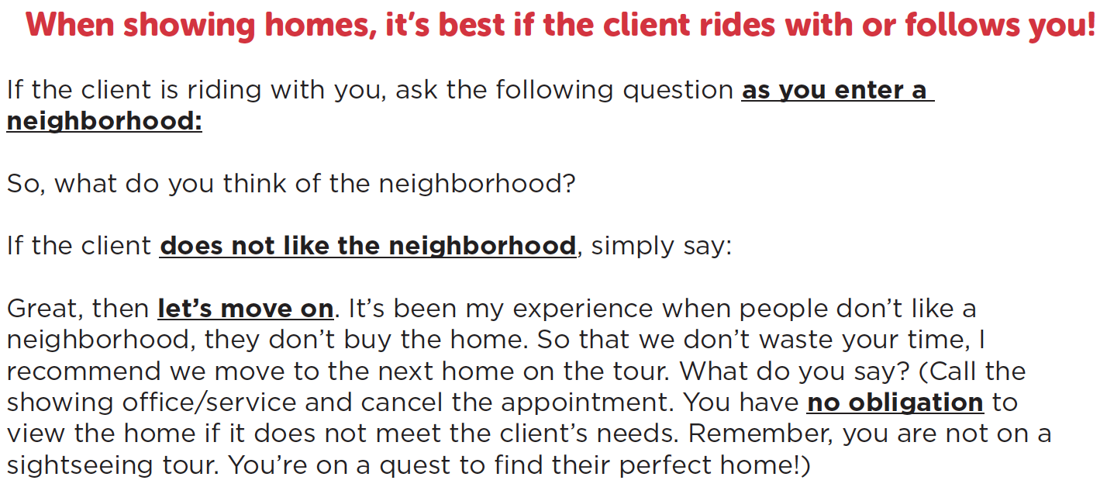
In The Car

Slide 54
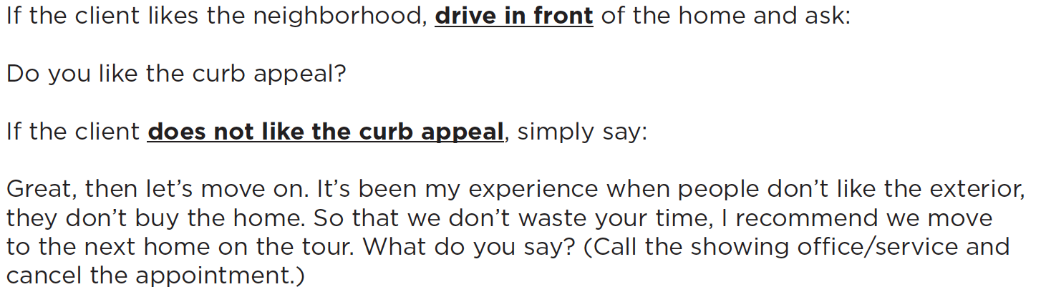
In The Car

Slide 55
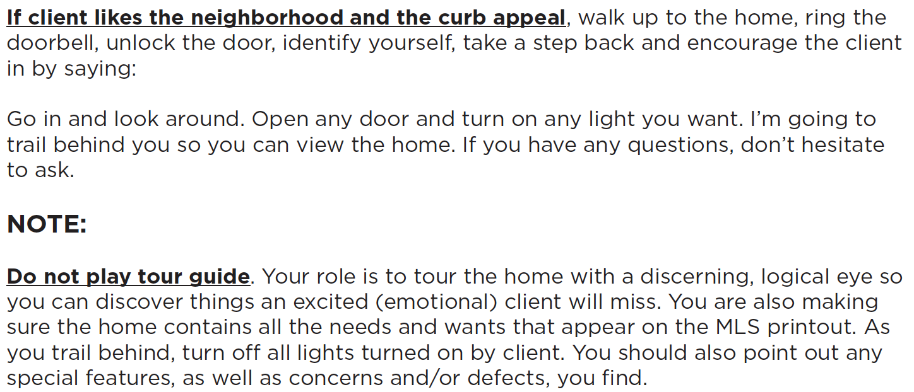
Show Homes

Slide 56
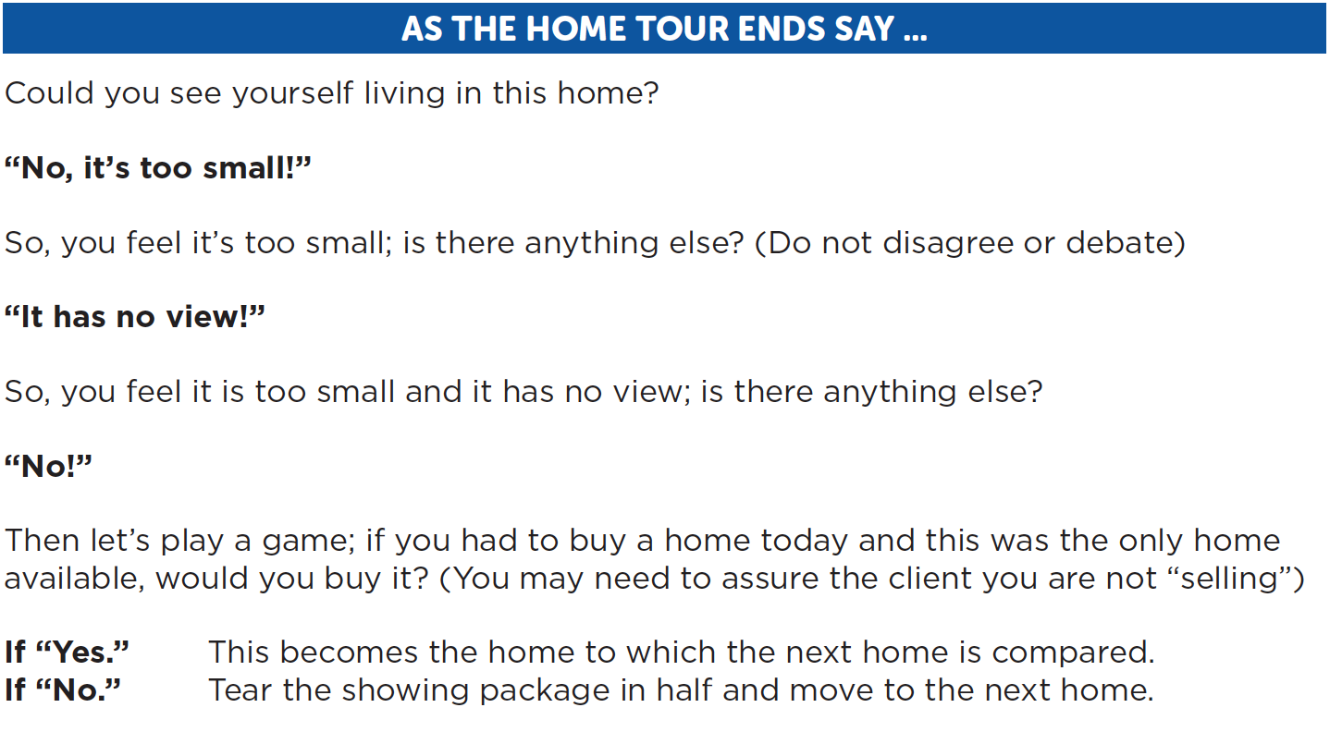
Show Homes

Slide 57
Show Homes
Tearing the showing package sends a dramatic and fun visual message that the home is no longer a viable option.

Slide 58
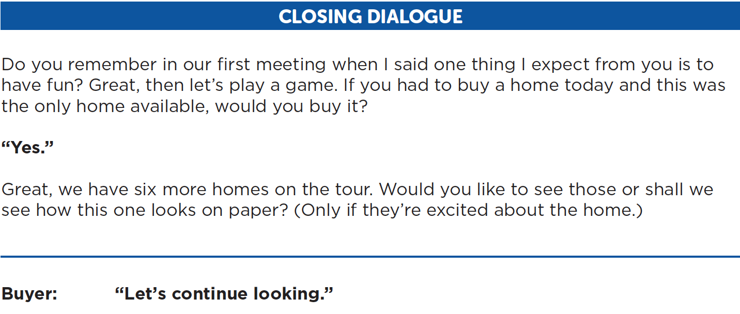
Sample Dialogue

Slide 59
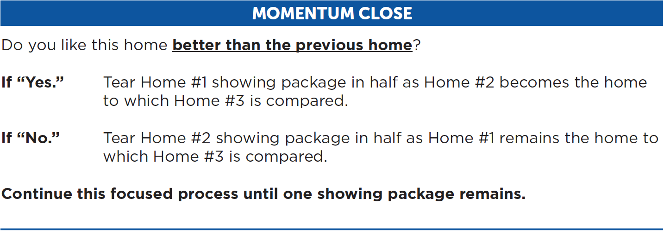
Sample Dialogue

Slide 60

Sample Dialogue

Slide 61

Close To The Offer

Slide 62

Close To The Offer

Slide 63

Low-Ball Offers

Slide 64

Low-Ball Offers

Slide 65

The Complete Buyer Process
Page 37

Slide 66

Supplemental Materials
Page 39

Slide 67

Supplemental Materials
Page 40

Slide 68

Supplemental Materials
Page 41

Slide 69

Supplemental Materials
Page 42

Slide 70
THANK YOU!

